Slide 1
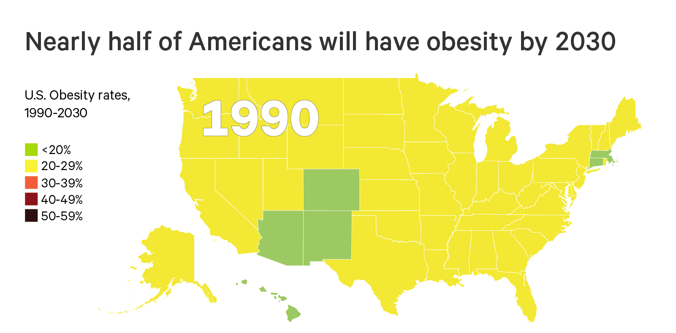
The Future of Obesity in the U.S.
Ward ZJ, Bleich SN, Cradock AL, Barrett JL, Giles CM, Flax CN, Long MW, Gortmaker SL. Projected U.S. State-Level Prevalence of Adult Obesity and Severe Obesity. New England Journal of Medicine. 2019;381:2440-50. doi: 10.1056/NEJMsa1909301

Slide 2
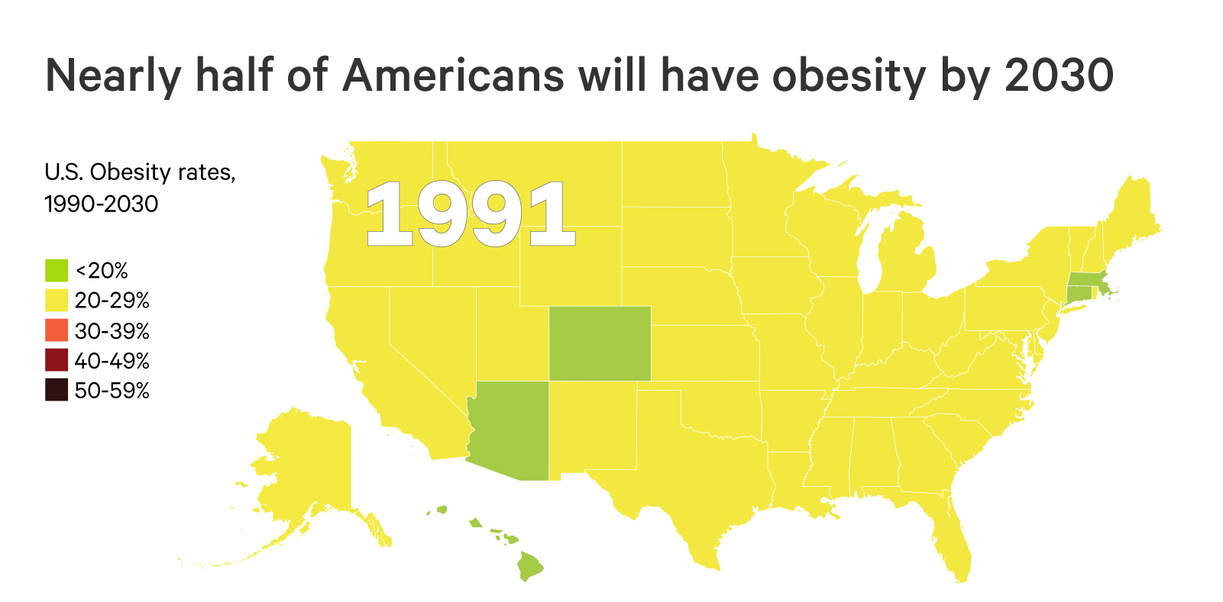
The Future of Obesity in the U.S.
Ward ZJ, Bleich SN, Cradock AL, Barrett JL, Giles CM, Flax CN, Long MW, Gortmaker SL. Projected U.S. State-Level Prevalence of Adult Obesity and Severe Obesity. New England Journal of Medicine. 2019;381:2440-50. doi: 10.1056/NEJMsa1909301

Slide 3
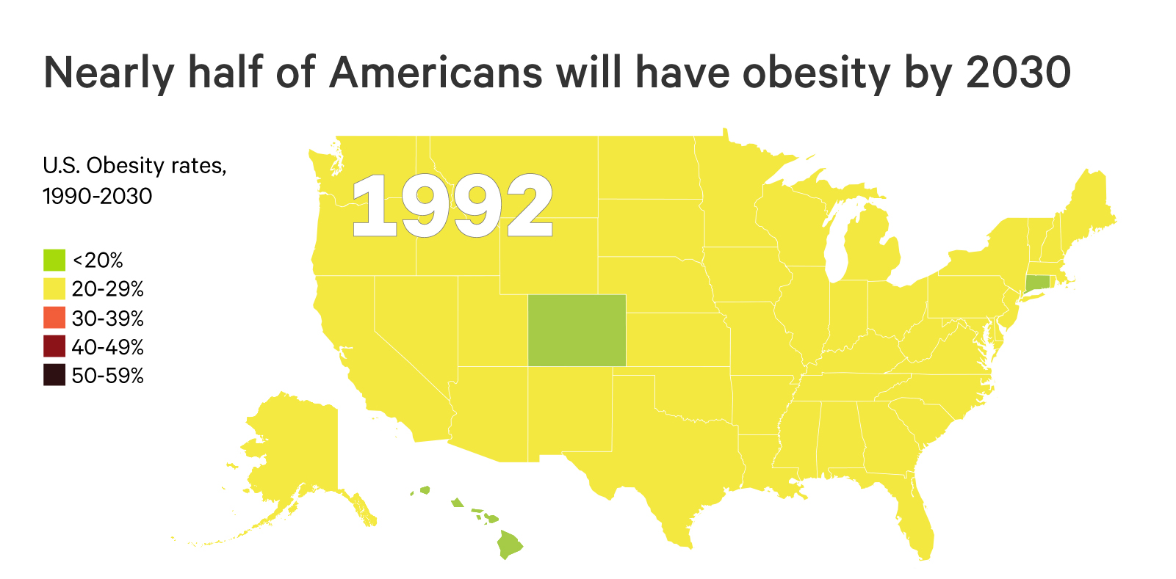
The Future of Obesity in the U.S.
Ward ZJ, Bleich SN, Cradock AL, Barrett JL, Giles CM, Flax CN, Long MW, Gortmaker SL. Projected U.S. State-Level Prevalence of Adult Obesity and Severe Obesity. New England Journal of Medicine. 2019;381:2440-50. doi: 10.1056/NEJMsa1909301

Slide 4
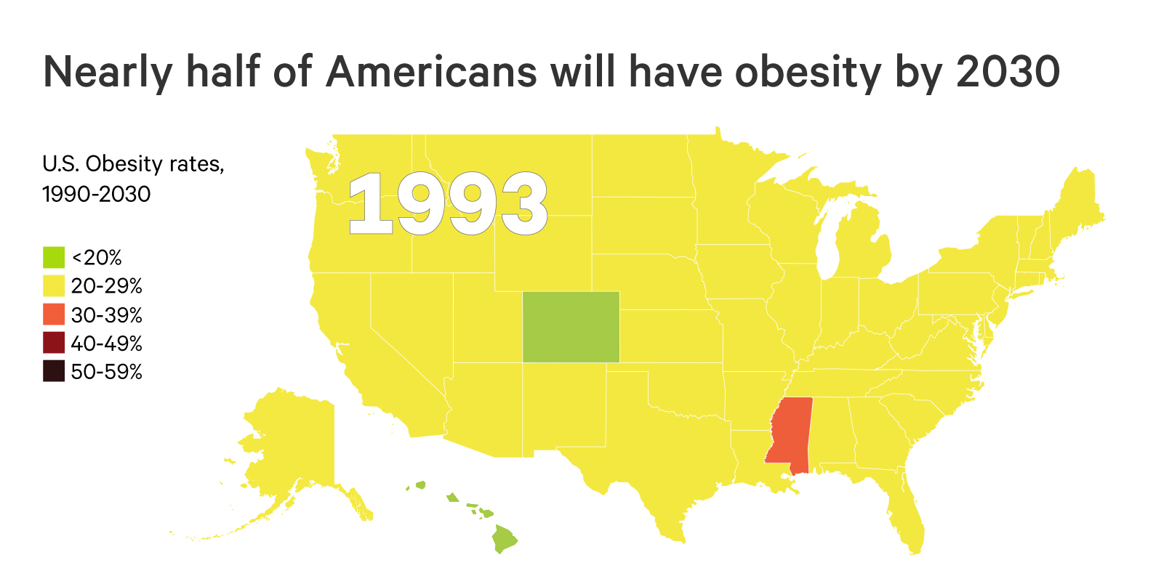
The Future of Obesity in the U.S.
Ward ZJ, Bleich SN, Cradock AL, Barrett JL, Giles CM, Flax CN, Long MW, Gortmaker SL. Projected U.S. State-Level Prevalence of Adult Obesity and Severe Obesity. New England Journal of Medicine. 2019;381:2440-50. doi: 10.1056/NEJMsa1909301

Slide 5
The Future of Obesity in the U.S.
Ward ZJ, Bleich SN, Cradock AL, Barrett JL, Giles CM, Flax CN, Long MW, Gortmaker SL. Projected U.S. State-Level Prevalence of Adult Obesity and Severe Obesity. New England Journal of Medicine. 2019;381:2440-50. doi: 10.1056/NEJMsa1909301

Slide 6
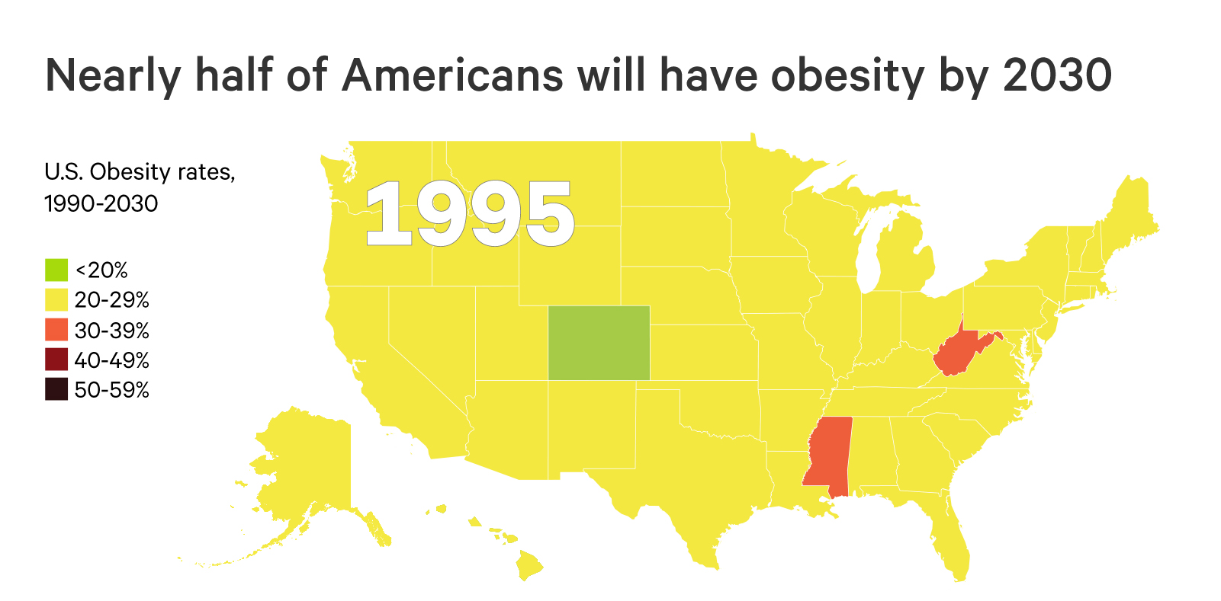
The Future of Obesity in the U.S.
Ward ZJ, Bleich SN, Cradock AL, Barrett JL, Giles CM, Flax CN, Long MW, Gortmaker SL. Projected U.S. State-Level Prevalence of Adult Obesity and Severe Obesity. New England Journal of Medicine. 2019;381:2440-50. doi: 10.1056/NEJMsa1909301

Slide 7
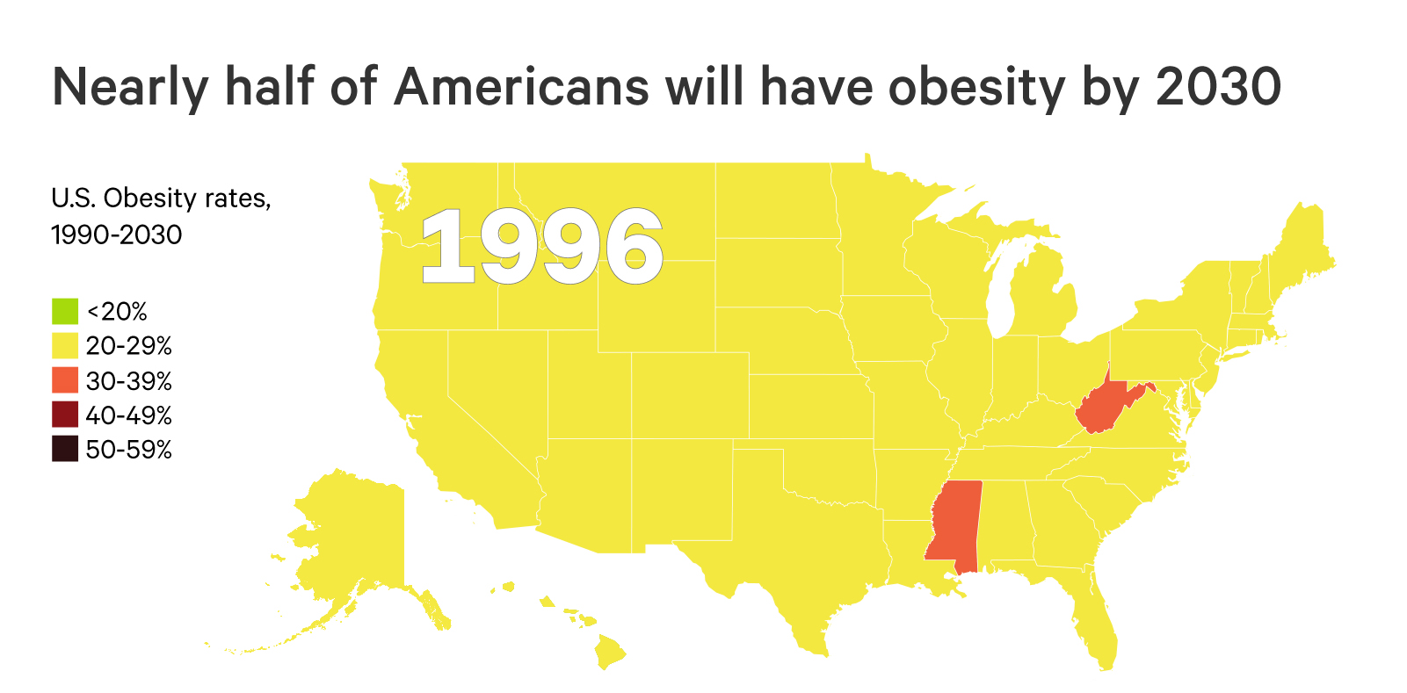
The Future of Obesity in the U.S.
Ward ZJ, Bleich SN, Cradock AL, Barrett JL, Giles CM, Flax CN, Long MW, Gortmaker SL. Projected U.S. State-Level Prevalence of Adult Obesity and Severe Obesity. New England Journal of Medicine. 2019;381:2440-50. doi: 10.1056/NEJMsa1909301

Slide 8
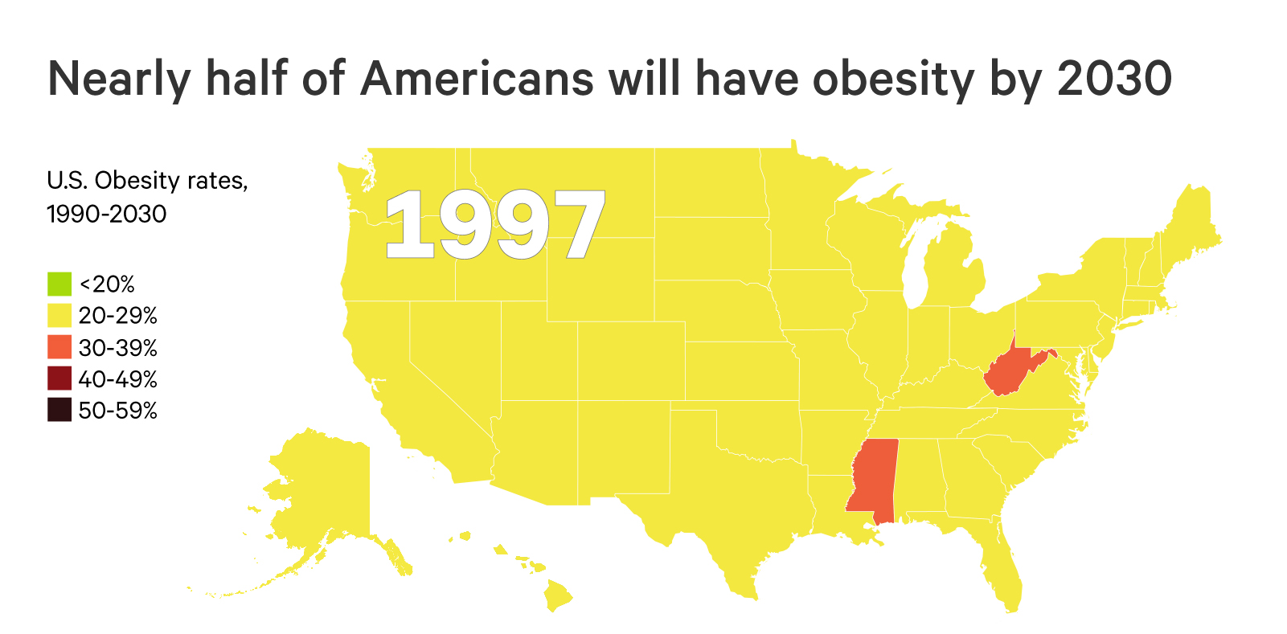
The Future of Obesity in the U.S.
Ward ZJ, Bleich SN, Cradock AL, Barrett JL, Giles CM, Flax CN, Long MW, Gortmaker SL. Projected U.S. State-Level Prevalence of Adult Obesity and Severe Obesity. New England Journal of Medicine. 2019;381:2440-50. doi: 10.1056/NEJMsa1909301

Slide 9
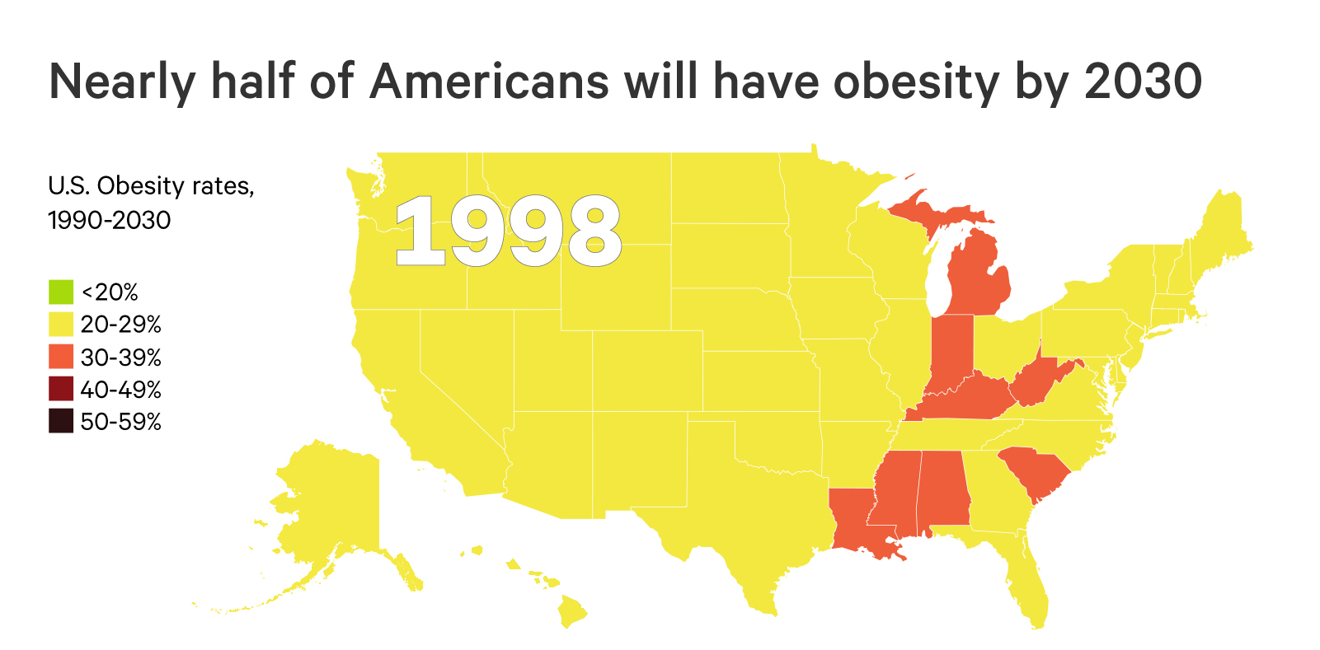
The Future of Obesity in the U.S.
Ward ZJ, Bleich SN, Cradock AL, Barrett JL, Giles CM, Flax CN, Long MW, Gortmaker SL. Projected U.S. State-Level Prevalence of Adult Obesity and Severe Obesity. New England Journal of Medicine. 2019;381:2440-50. doi: 10.1056/NEJMsa1909301

Slide 10
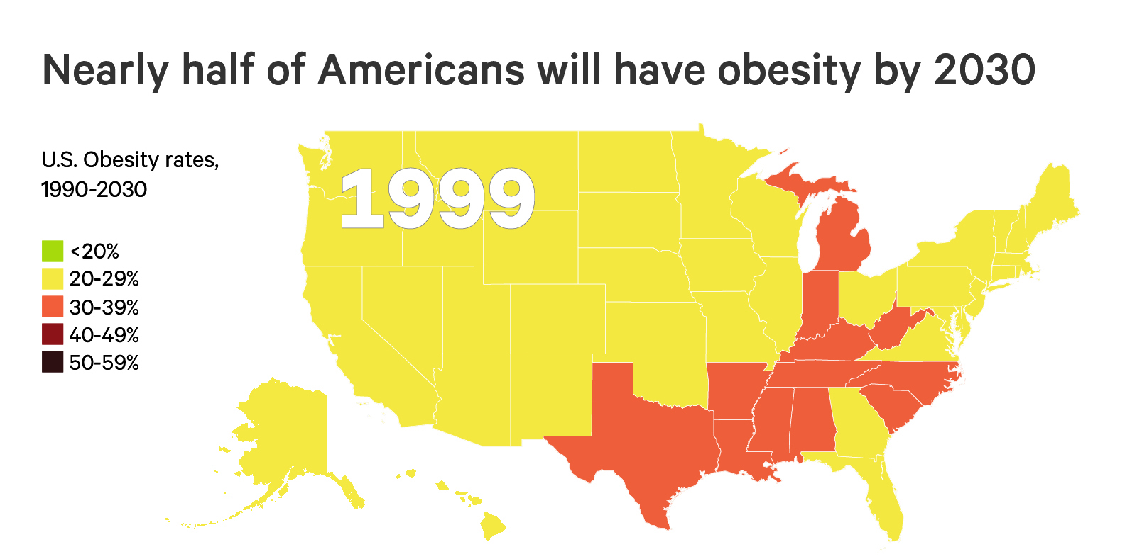
The Future of Obesity in the U.S.
Ward ZJ, Bleich SN, Cradock AL, Barrett JL, Giles CM, Flax CN, Long MW, Gortmaker SL. Projected U.S. State-Level Prevalence of Adult Obesity and Severe Obesity. New England Journal of Medicine. 2019;381:2440-50. doi: 10.1056/NEJMsa1909301

Slide 11
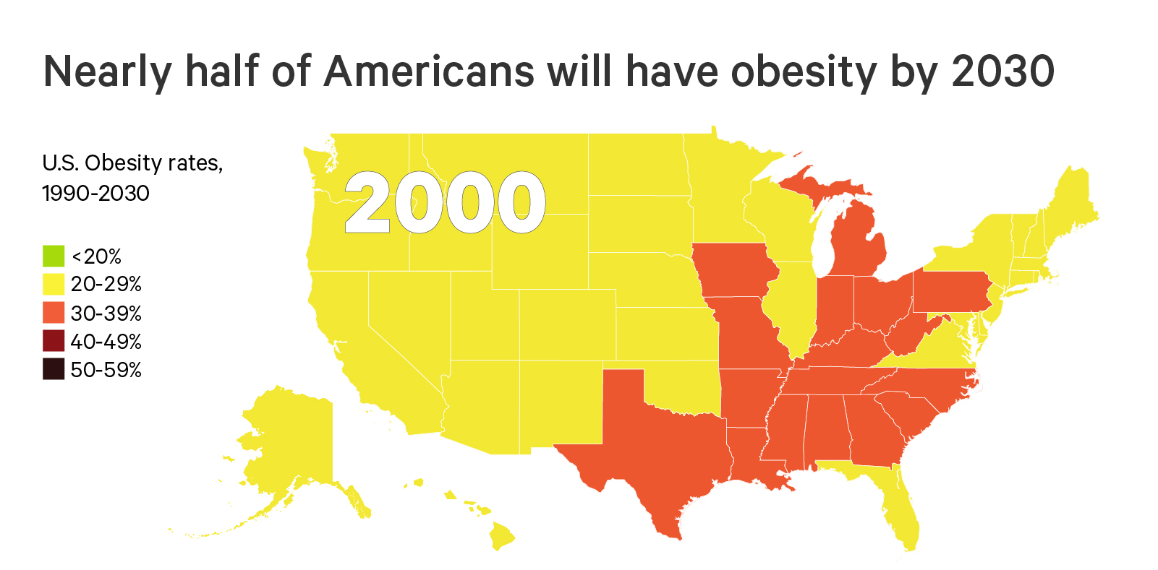
The Future of Obesity in the U.S.
Ward ZJ, Bleich SN, Cradock AL, Barrett JL, Giles CM, Flax CN, Long MW, Gortmaker SL. Projected U.S. State-Level Prevalence of Adult Obesity and Severe Obesity. New England Journal of Medicine. 2019;381:2440-50. doi: 10.1056/NEJMsa1909301

Slide 12
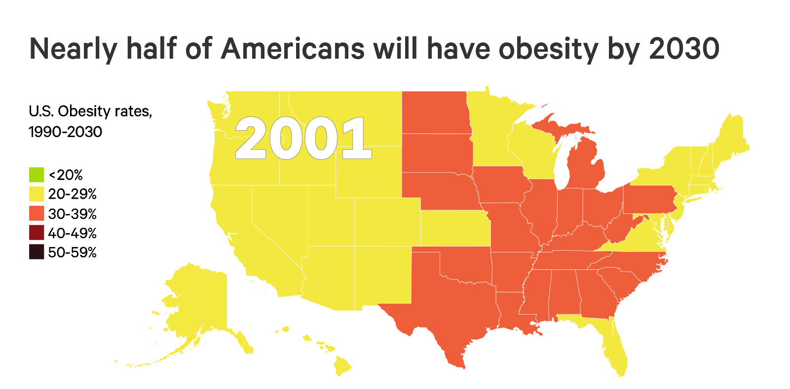
The Future of Obesity in the U.S.
Ward ZJ, Bleich SN, Cradock AL, Barrett JL, Giles CM, Flax CN, Long MW, Gortmaker SL. Projected U.S. State-Level Prevalence of Adult Obesity and Severe Obesity. New England Journal of Medicine. 2019;381:2440-50. doi: 10.1056/NEJMsa1909301

Slide 13
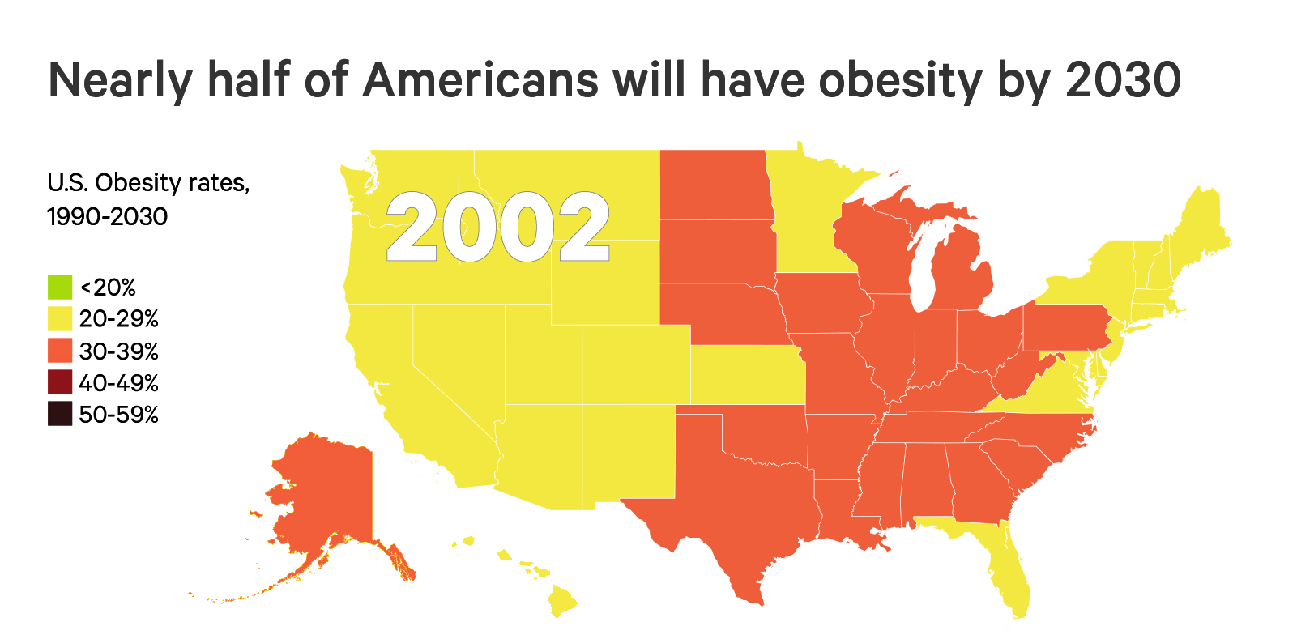
The Future of Obesity in the U.S.
Ward ZJ, Bleich SN, Cradock AL, Barrett JL, Giles CM, Flax CN, Long MW, Gortmaker SL. Projected U.S. State-Level Prevalence of Adult Obesity and Severe Obesity. New England Journal of Medicine. 2019;381:2440-50. doi: 10.1056/NEJMsa1909301

Slide 14
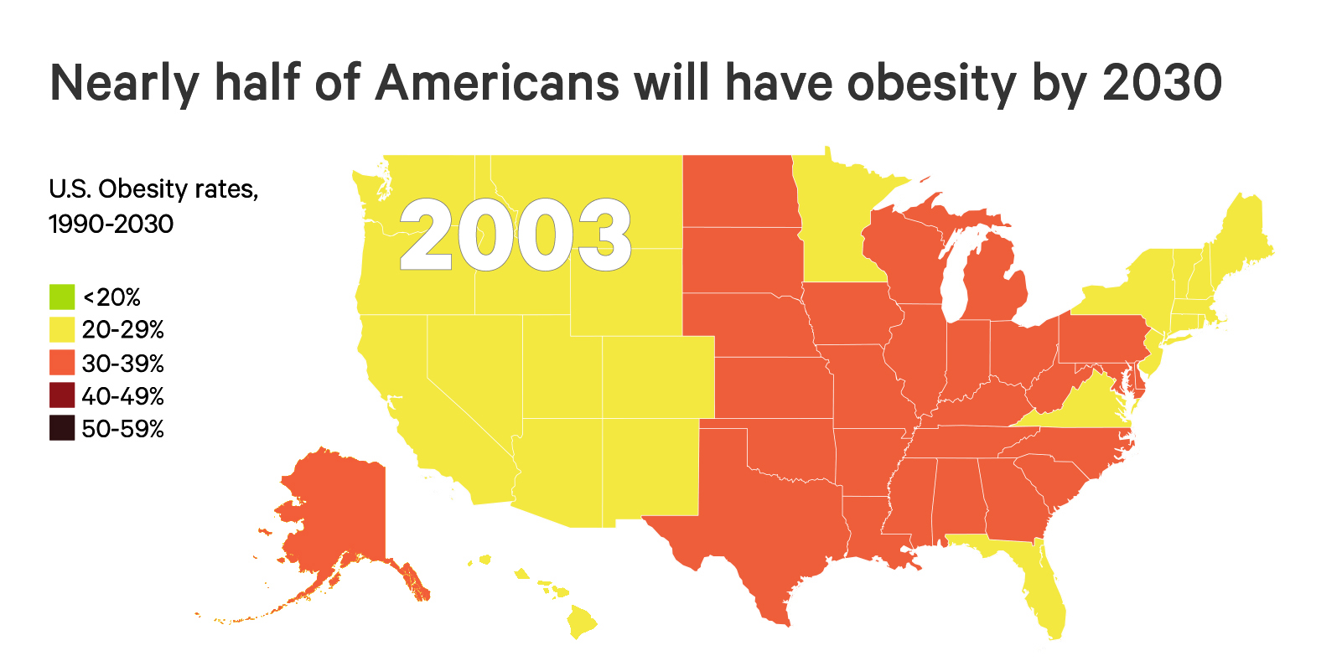
The Future of Obesity in the U.S.
Ward ZJ, Bleich SN, Cradock AL, Barrett JL, Giles CM, Flax CN, Long MW, Gortmaker SL. Projected U.S. State-Level Prevalence of Adult Obesity and Severe Obesity. New England Journal of Medicine. 2019;381:2440-50. doi: 10.1056/NEJMsa1909301

Slide 15
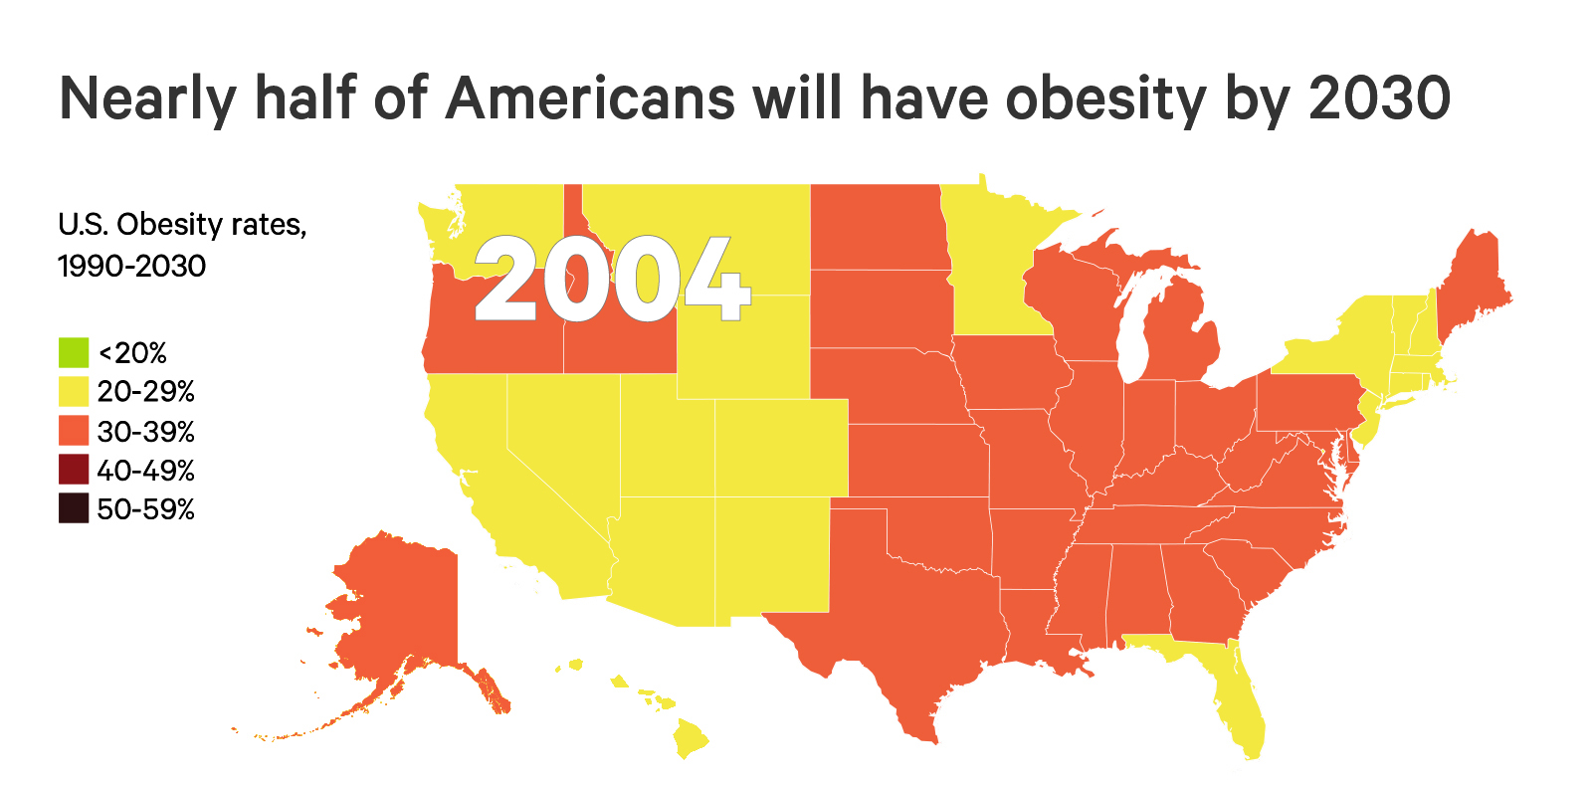
The Future of Obesity in the U.S.
Ward ZJ, Bleich SN, Cradock AL, Barrett JL, Giles CM, Flax CN, Long MW, Gortmaker SL. Projected U.S. State-Level Prevalence of Adult Obesity and Severe Obesity. New England Journal of Medicine. 2019;381:2440-50. doi: 10.1056/NEJMsa1909301

Slide 16
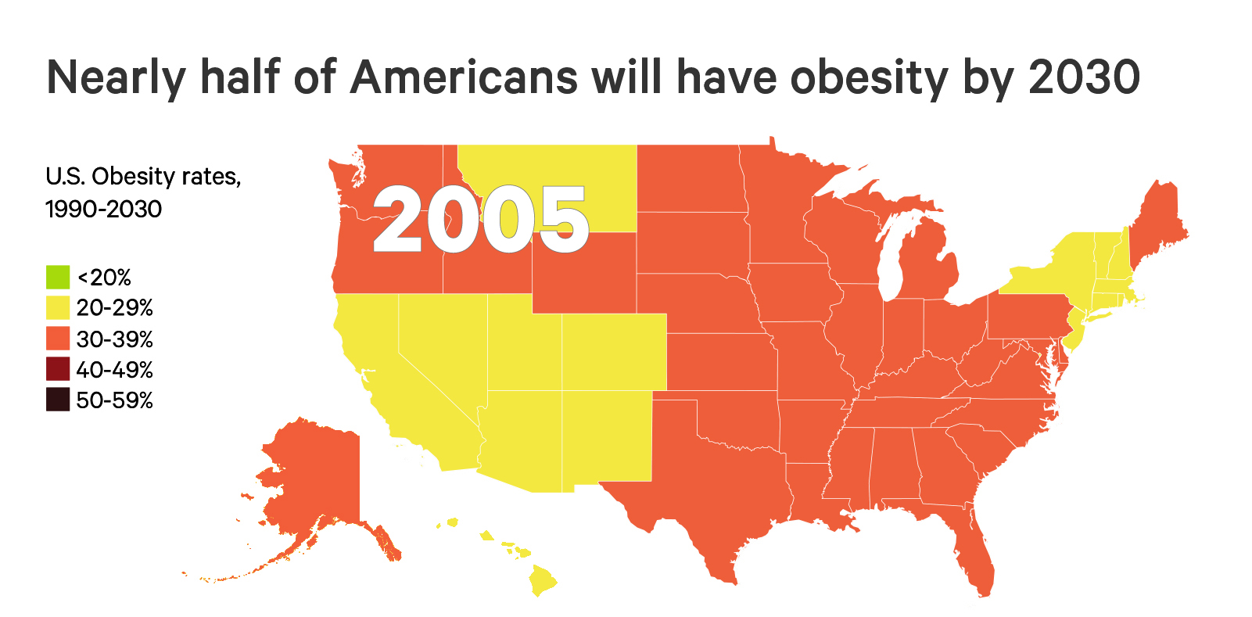
The Future of Obesity in the U.S.
Ward ZJ, Bleich SN, Cradock AL, Barrett JL, Giles CM, Flax CN, Long MW, Gortmaker SL. Projected U.S. State-Level Prevalence of Adult Obesity and Severe Obesity. New England Journal of Medicine. 2019;381:2440-50. doi: 10.1056/NEJMsa1909301

Slide 17
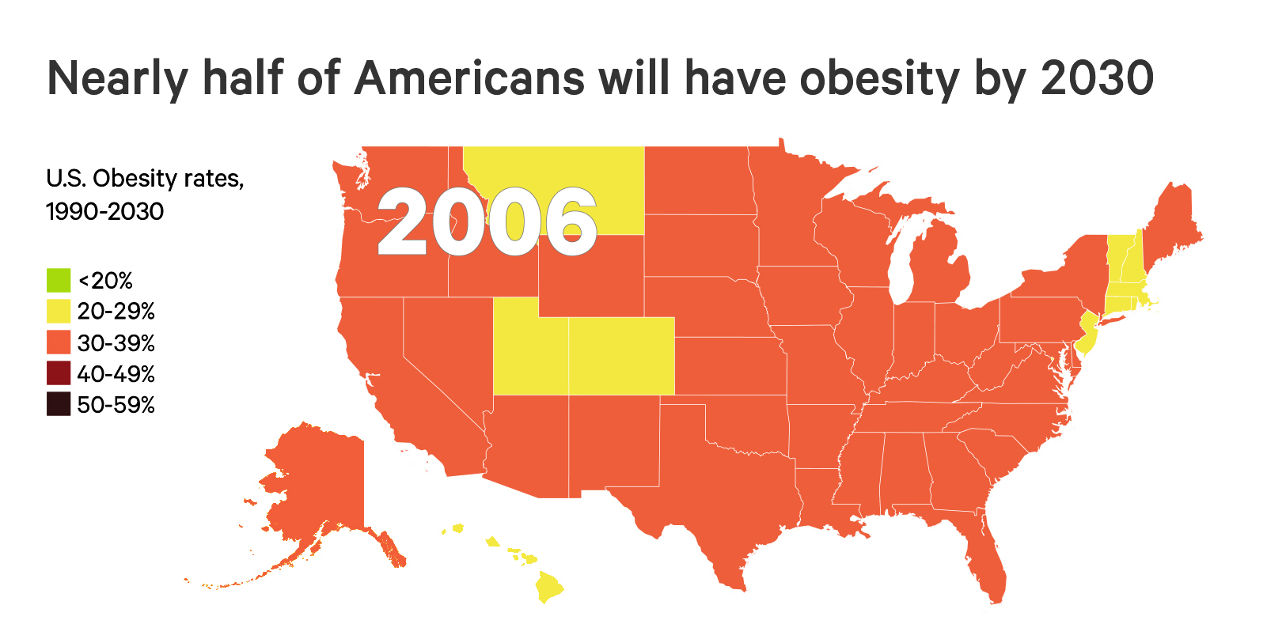
The Future of Obesity in the U.S.
Ward ZJ, Bleich SN, Cradock AL, Barrett JL, Giles CM, Flax CN, Long MW, Gortmaker SL. Projected U.S. State-Level Prevalence of Adult Obesity and Severe Obesity. New England Journal of Medicine. 2019;381:2440-50. doi: 10.1056/NEJMsa1909301

Slide 18
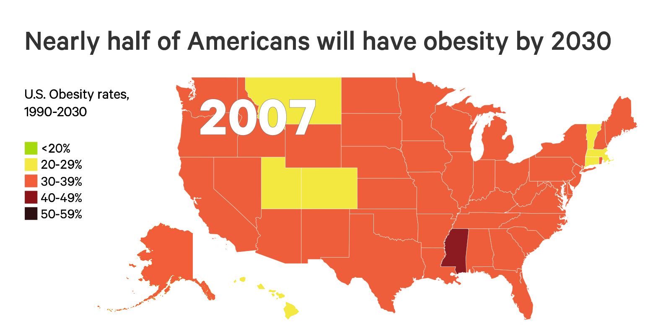
The Future of Obesity in the U.S.
Ward ZJ, Bleich SN, Cradock AL, Barrett JL, Giles CM, Flax CN, Long MW, Gortmaker SL. Projected U.S. State-Level Prevalence of Adult Obesity and Severe Obesity. New England Journal of Medicine. 2019;381:2440-50. doi: 10.1056/NEJMsa1909301

Slide 19
The Future of Obesity in the U.S.
Ward ZJ, Bleich SN, Cradock AL, Barrett JL, Giles CM, Flax CN, Long MW, Gortmaker SL. Projected U.S. State-Level Prevalence of Adult Obesity and Severe Obesity. New England Journal of Medicine. 2019;381:2440-50. doi: 10.1056/NEJMsa1909301

Slide 20
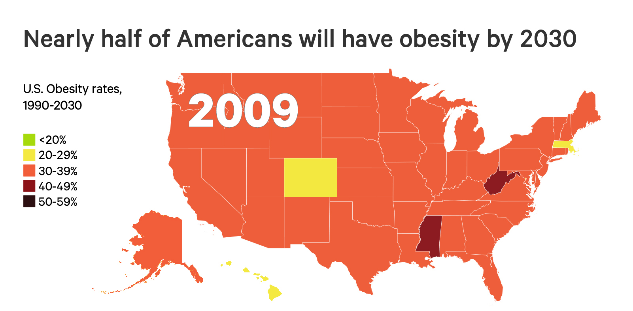
The Future of Obesity in the U.S.
Ward ZJ, Bleich SN, Cradock AL, Barrett JL, Giles CM, Flax CN, Long MW, Gortmaker SL. Projected U.S. State-Level Prevalence of Adult Obesity and Severe Obesity. New England Journal of Medicine. 2019;381:2440-50. doi: 10.1056/NEJMsa1909301

Slide 21
The Future of Obesity in the U.S.
Ward ZJ, Bleich SN, Cradock AL, Barrett JL, Giles CM, Flax CN, Long MW, Gortmaker SL. Projected U.S. State-Level Prevalence of Adult Obesity and Severe Obesity. New England Journal of Medicine. 2019;381:2440-50. doi: 10.1056/NEJMsa1909301

Slide 22
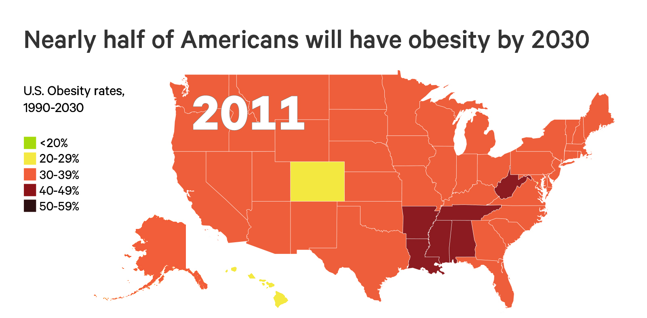
The Future of Obesity in the U.S.
Ward ZJ, Bleich SN, Cradock AL, Barrett JL, Giles CM, Flax CN, Long MW, Gortmaker SL. Projected U.S. State-Level Prevalence of Adult Obesity and Severe Obesity. New England Journal of Medicine. 2019;381:2440-50. doi: 10.1056/NEJMsa1909301

Slide 23
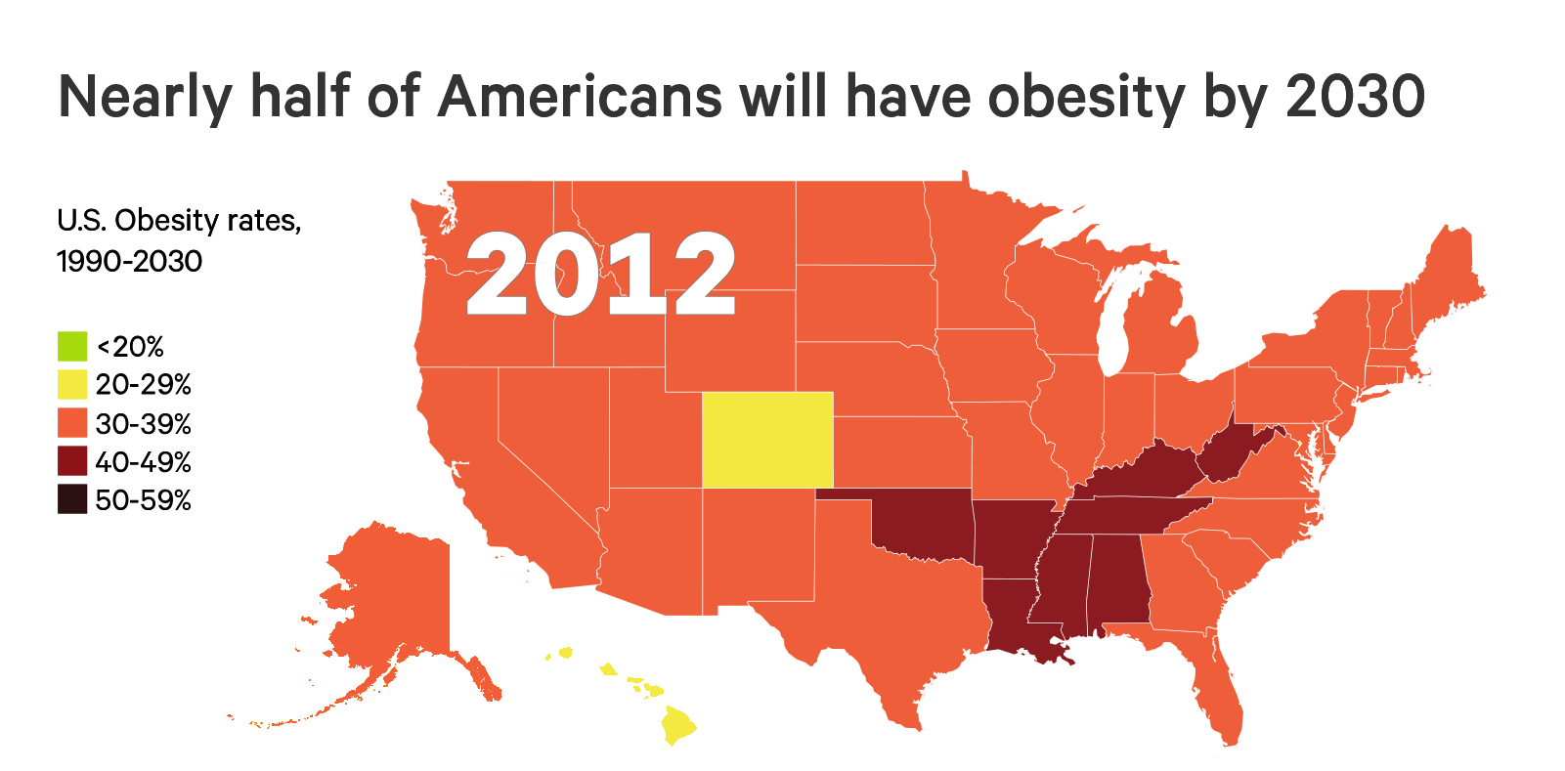
The Future of Obesity in the U.S.
Ward ZJ, Bleich SN, Cradock AL, Barrett JL, Giles CM, Flax CN, Long MW, Gortmaker SL. Projected U.S. State-Level Prevalence of Adult Obesity and Severe Obesity. New England Journal of Medicine. 2019;381:2440-50. doi: 10.1056/NEJMsa1909301

Slide 24
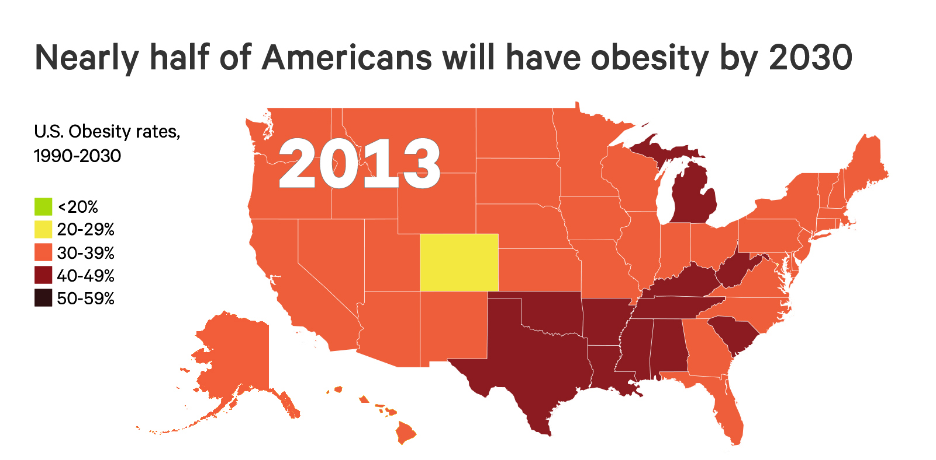
The Future of Obesity in the U.S.
Ward ZJ, Bleich SN, Cradock AL, Barrett JL, Giles CM, Flax CN, Long MW, Gortmaker SL. Projected U.S. State-Level Prevalence of Adult Obesity and Severe Obesity. New England Journal of Medicine. 2019;381:2440-50. doi: 10.1056/NEJMsa1909301

Slide 25
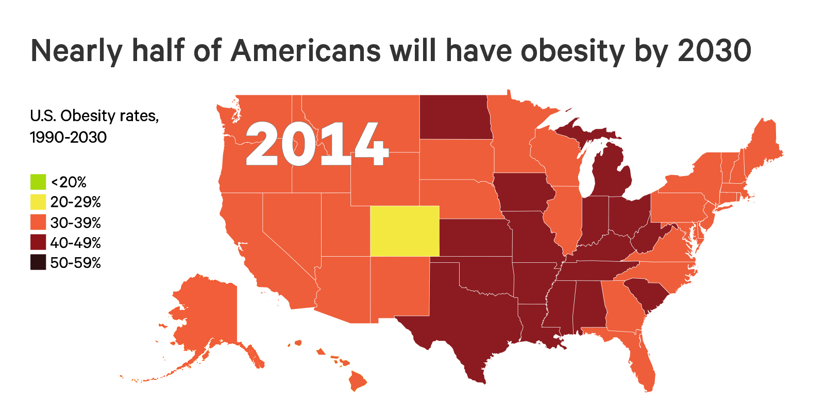
The Future of Obesity in the U.S.
Ward ZJ, Bleich SN, Cradock AL, Barrett JL, Giles CM, Flax CN, Long MW, Gortmaker SL. Projected U.S. State-Level Prevalence of Adult Obesity and Severe Obesity. New England Journal of Medicine. 2019;381:2440-50. doi: 10.1056/NEJMsa1909301

Slide 26
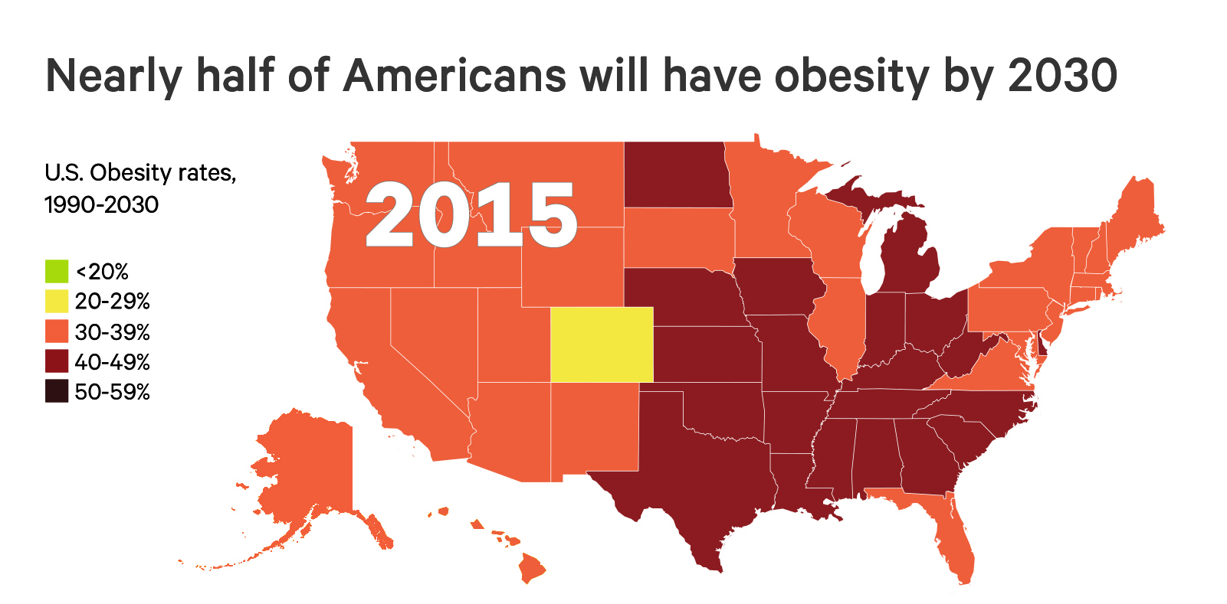
The Future of Obesity in the U.S.
Ward ZJ, Bleich SN, Cradock AL, Barrett JL, Giles CM, Flax CN, Long MW, Gortmaker SL. Projected U.S. State-Level Prevalence of Adult Obesity and Severe Obesity. New England Journal of Medicine. 2019;381:2440-50. doi: 10.1056/NEJMsa1909301

Slide 27
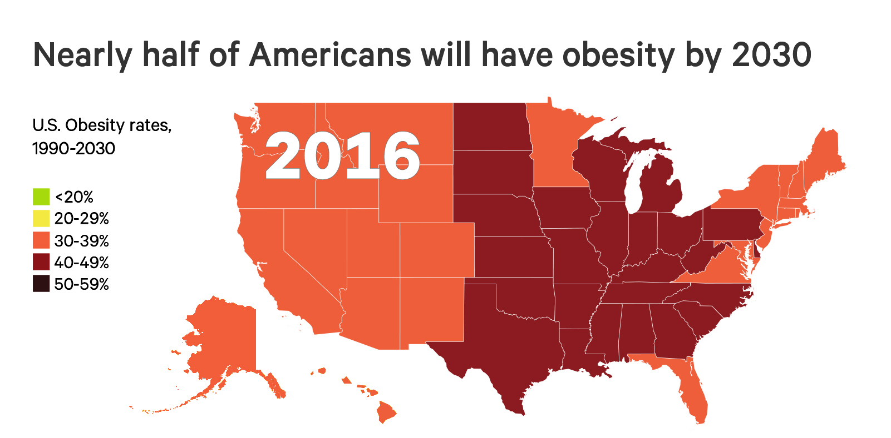
The Future of Obesity in the U.S.
Ward ZJ, Bleich SN, Cradock AL, Barrett JL, Giles CM, Flax CN, Long MW, Gortmaker SL. Projected U.S. State-Level Prevalence of Adult Obesity and Severe Obesity. New England Journal of Medicine. 2019;381:2440-50. doi: 10.1056/NEJMsa1909301

Slide 28
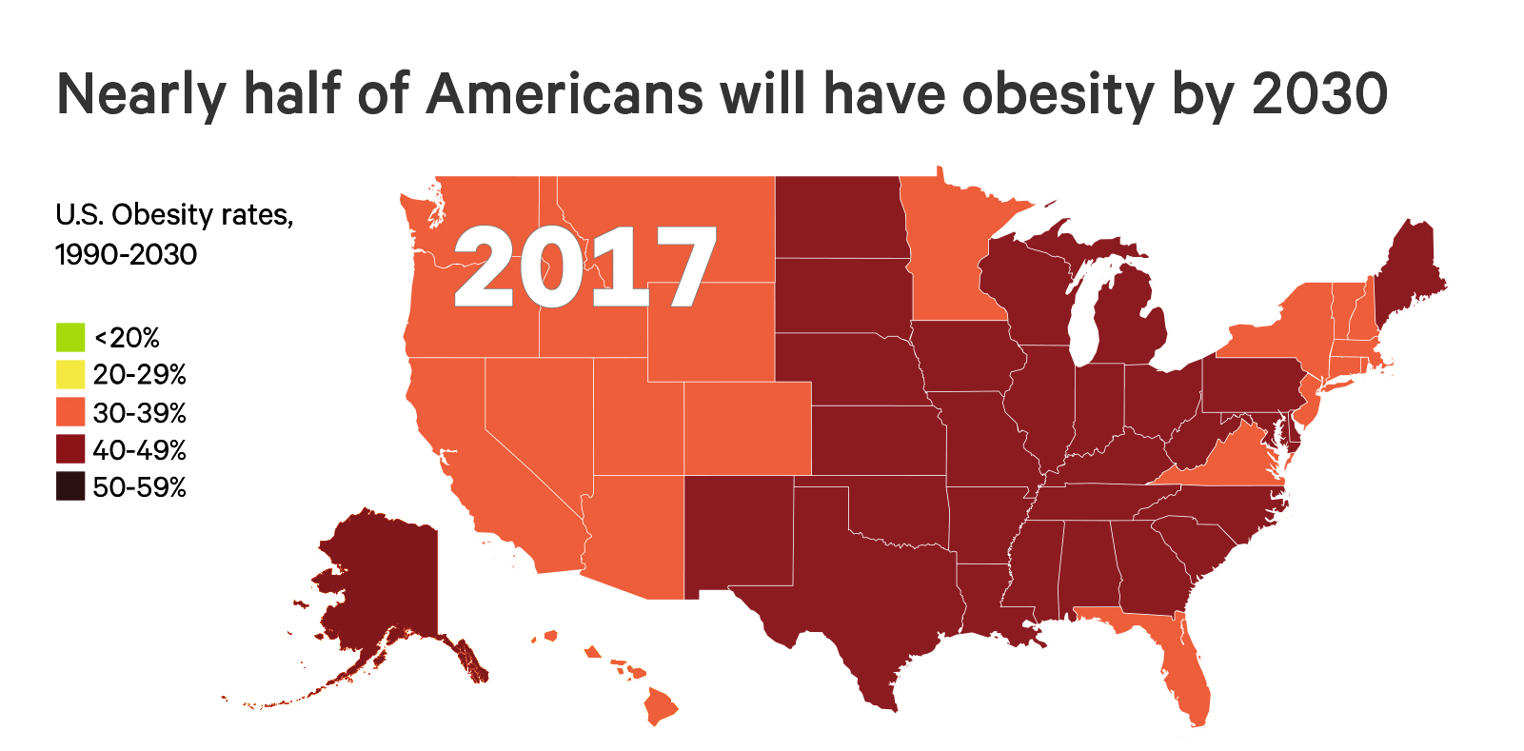
The Future of Obesity in the U.S.
Ward ZJ, Bleich SN, Cradock AL, Barrett JL, Giles CM, Flax CN, Long MW, Gortmaker SL. Projected U.S. State-Level Prevalence of Adult Obesity and Severe Obesity. New England Journal of Medicine. 2019;381:2440-50. doi: 10.1056/NEJMsa1909301

Slide 29
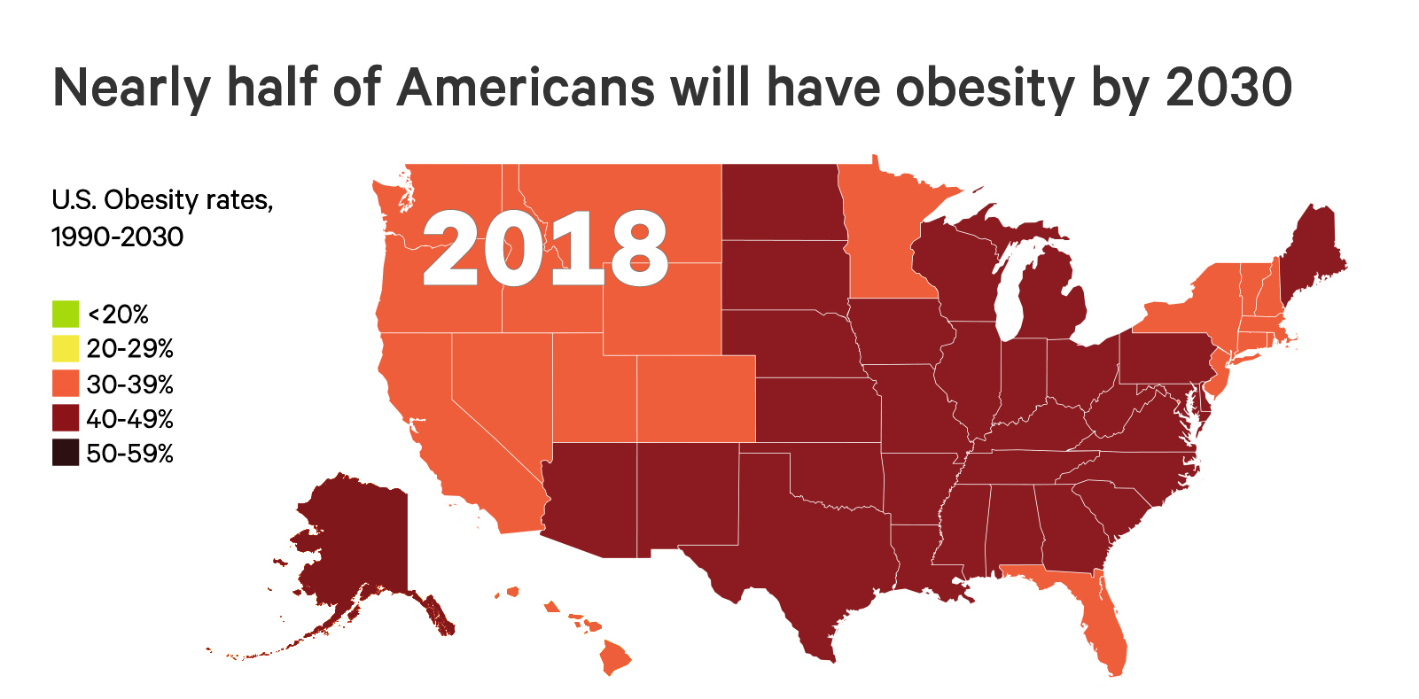
The Future of Obesity in the U.S.
Ward ZJ, Bleich SN, Cradock AL, Barrett JL, Giles CM, Flax CN, Long MW, Gortmaker SL. Projected U.S. State-Level Prevalence of Adult Obesity and Severe Obesity. New England Journal of Medicine. 2019;381:2440-50. doi: 10.1056/NEJMsa1909301

Slide 30
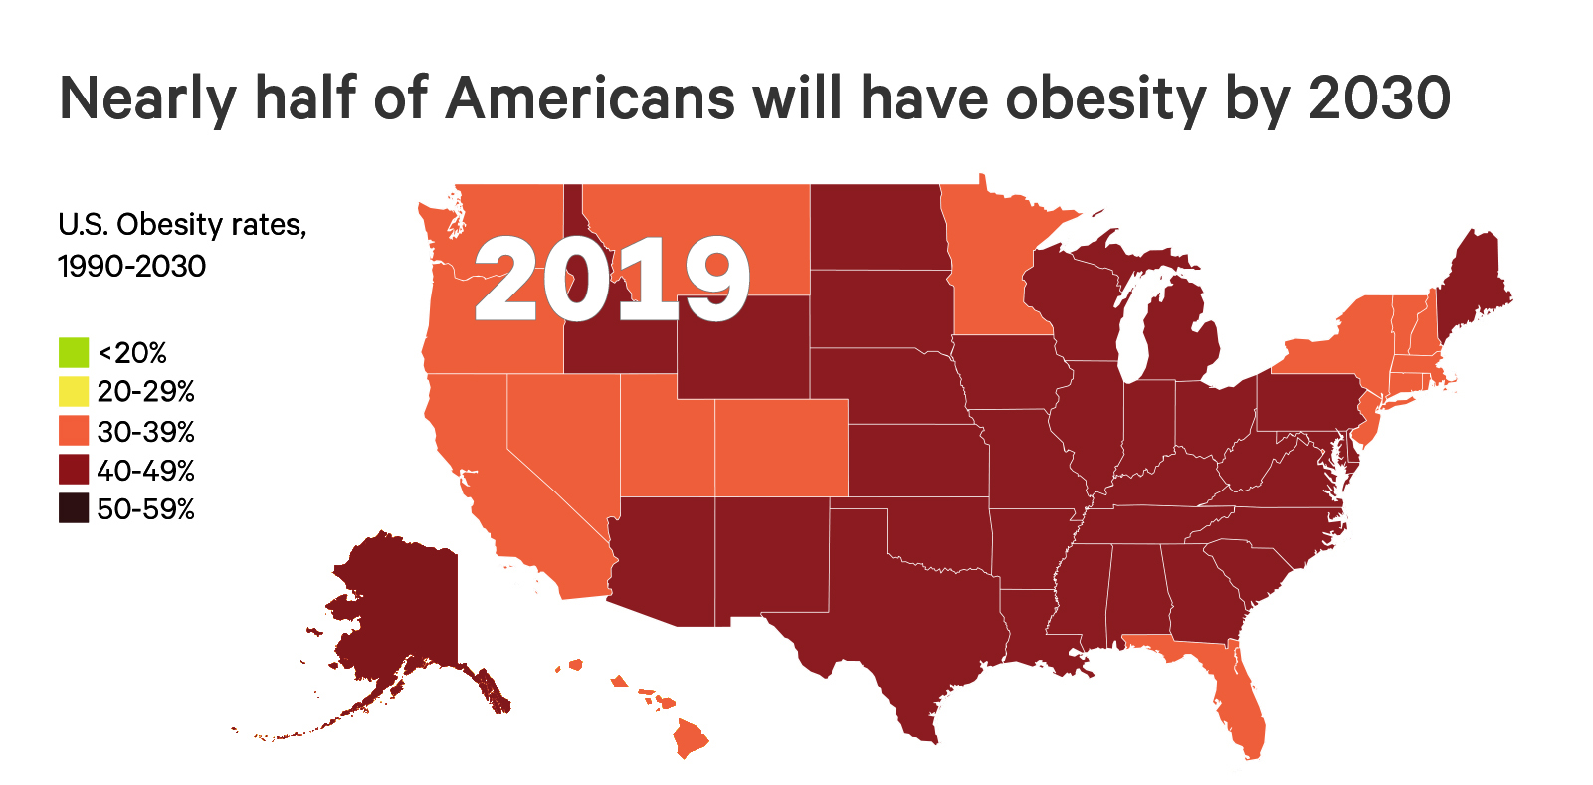
The Future of Obesity in the U.S.
Ward ZJ, Bleich SN, Cradock AL, Barrett JL, Giles CM, Flax CN, Long MW, Gortmaker SL. Projected U.S. State-Level Prevalence of Adult Obesity and Severe Obesity. New England Journal of Medicine. 2019;381:2440-50. doi: 10.1056/NEJMsa1909301

Slide 31
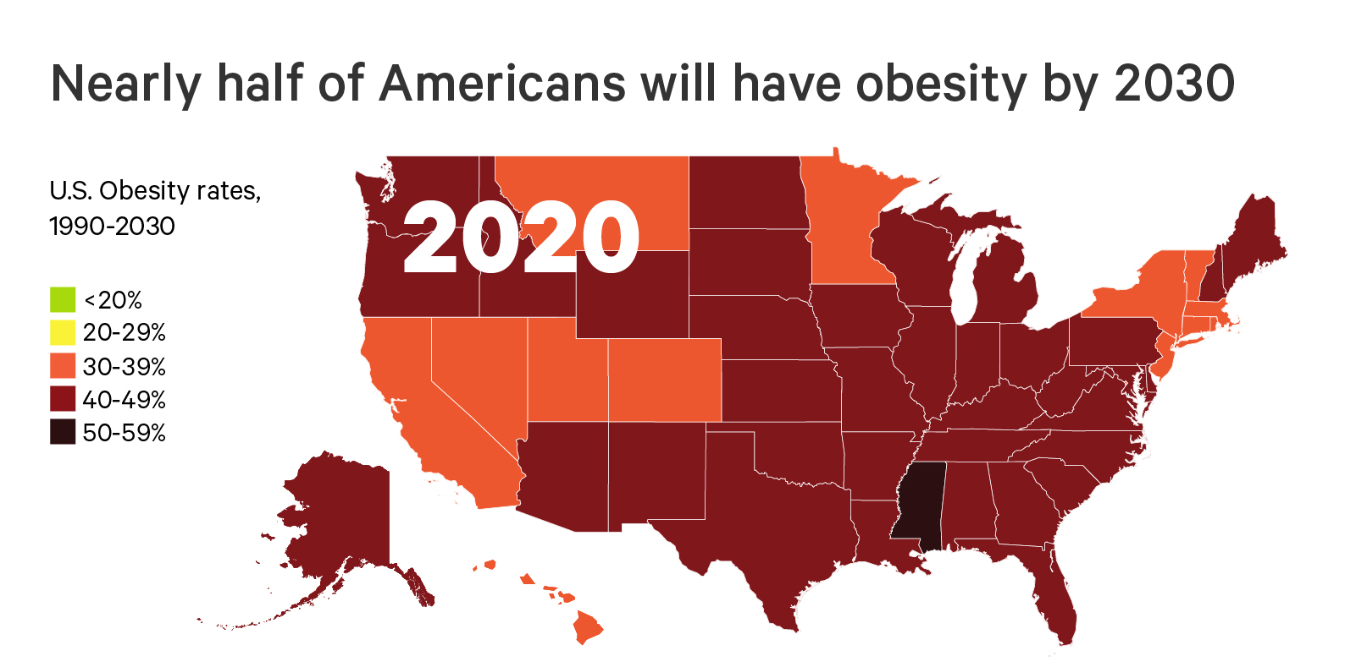
The Future of Obesity in the U.S.
Ward ZJ, Bleich SN, Cradock AL, Barrett JL, Giles CM, Flax CN, Long MW, Gortmaker SL. Projected U.S. State-Level Prevalence of Adult Obesity and Severe Obesity. New England Journal of Medicine. 2019;381:2440-50. doi: 10.1056/NEJMsa1909301

Slide 32
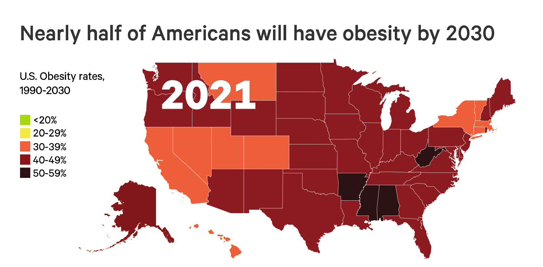
The Future of Obesity in the U.S.
Ward ZJ, Bleich SN, Cradock AL, Barrett JL, Giles CM, Flax CN, Long MW, Gortmaker SL. Projected U.S. State-Level Prevalence of Adult Obesity and Severe Obesity. New England Journal of Medicine. 2019;381:2440-50. doi: 10.1056/NEJMsa1909301

Slide 33
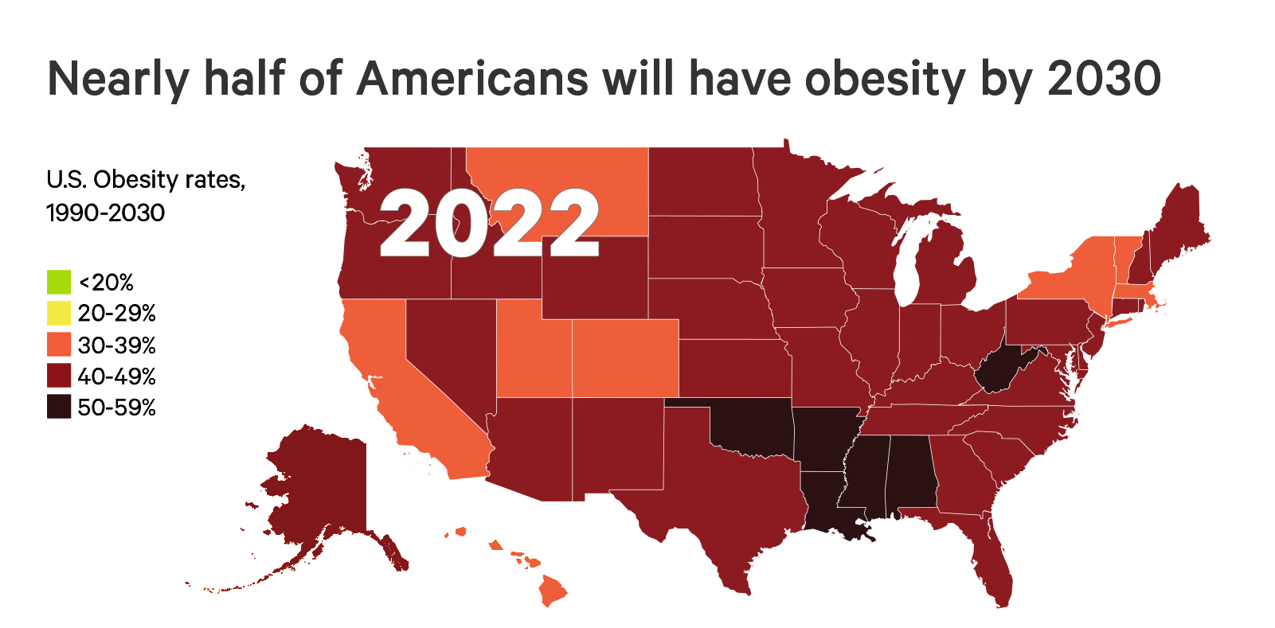
The Future of Obesity in the U.S.
Ward ZJ, Bleich SN, Cradock AL, Barrett JL, Giles CM, Flax CN, Long MW, Gortmaker SL. Projected U.S. State-Level Prevalence of Adult Obesity and Severe Obesity. New England Journal of Medicine. 2019;381:2440-50. doi: 10.1056/NEJMsa1909301

Slide 34
The Future of Obesity in the U.S.
Ward ZJ, Bleich SN, Cradock AL, Barrett JL, Giles CM, Flax CN, Long MW, Gortmaker SL. Projected U.S. State-Level Prevalence of Adult Obesity and Severe Obesity. New England Journal of Medicine. 2019;381:2440-50. doi: 10.1056/NEJMsa1909301

Slide 35
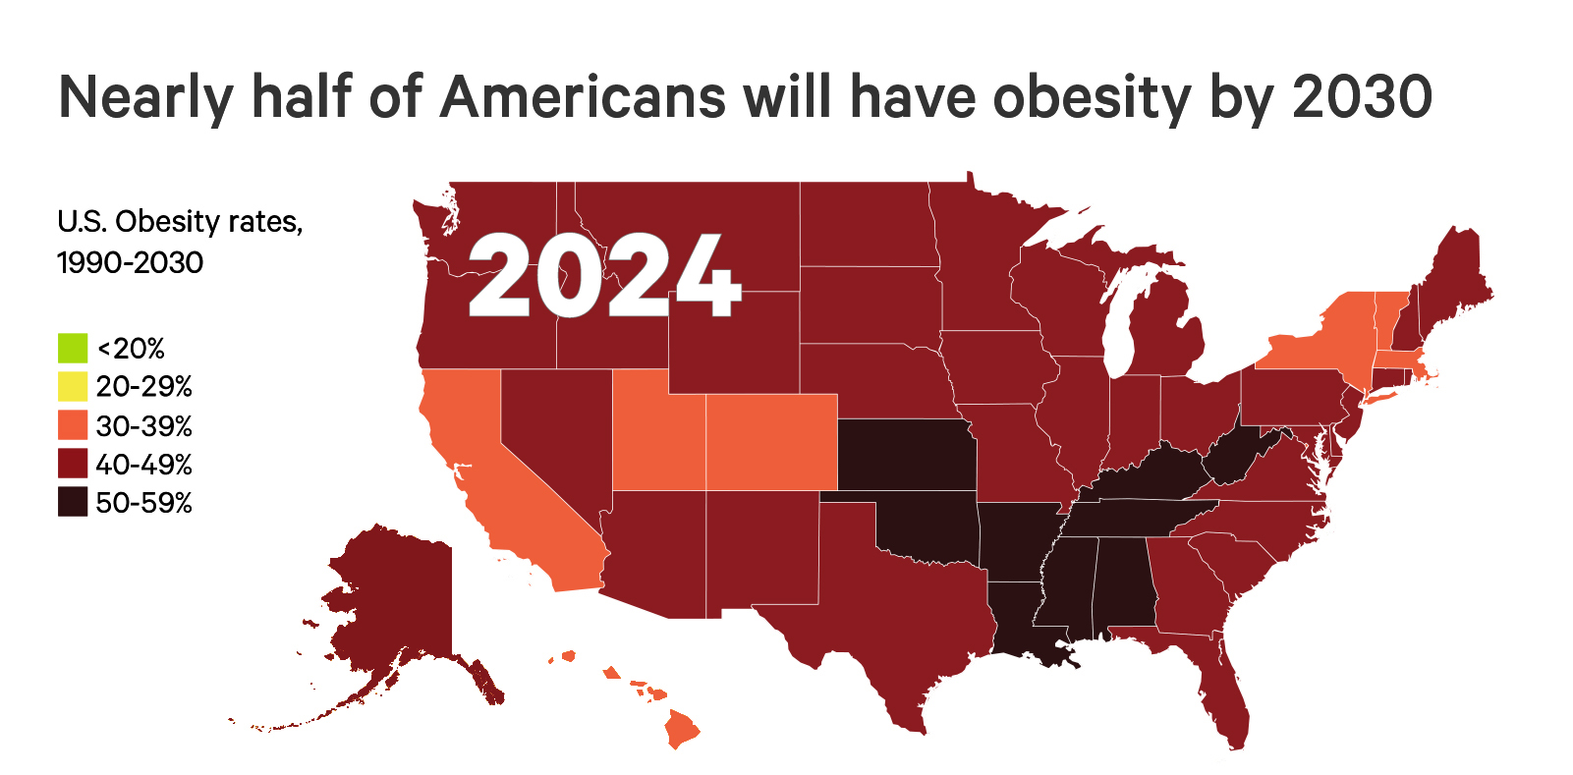
The Future of Obesity in the U.S.
Ward ZJ, Bleich SN, Cradock AL, Barrett JL, Giles CM, Flax CN, Long MW, Gortmaker SL. Projected U.S. State-Level Prevalence of Adult Obesity and Severe Obesity. New England Journal of Medicine. 2019;381:2440-50. doi: 10.1056/NEJMsa1909301

Slide 36
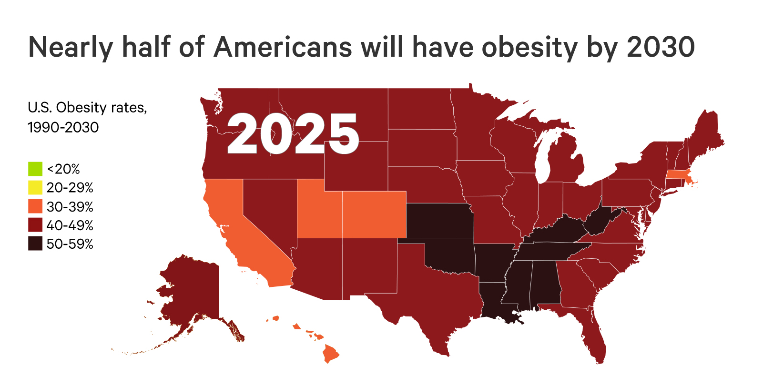
The Future of Obesity in the U.S.
Ward ZJ, Bleich SN, Cradock AL, Barrett JL, Giles CM, Flax CN, Long MW, Gortmaker SL. Projected U.S. State-Level Prevalence of Adult Obesity and Severe Obesity. New England Journal of Medicine. 2019;381:2440-50. doi: 10.1056/NEJMsa1909301

Slide 37
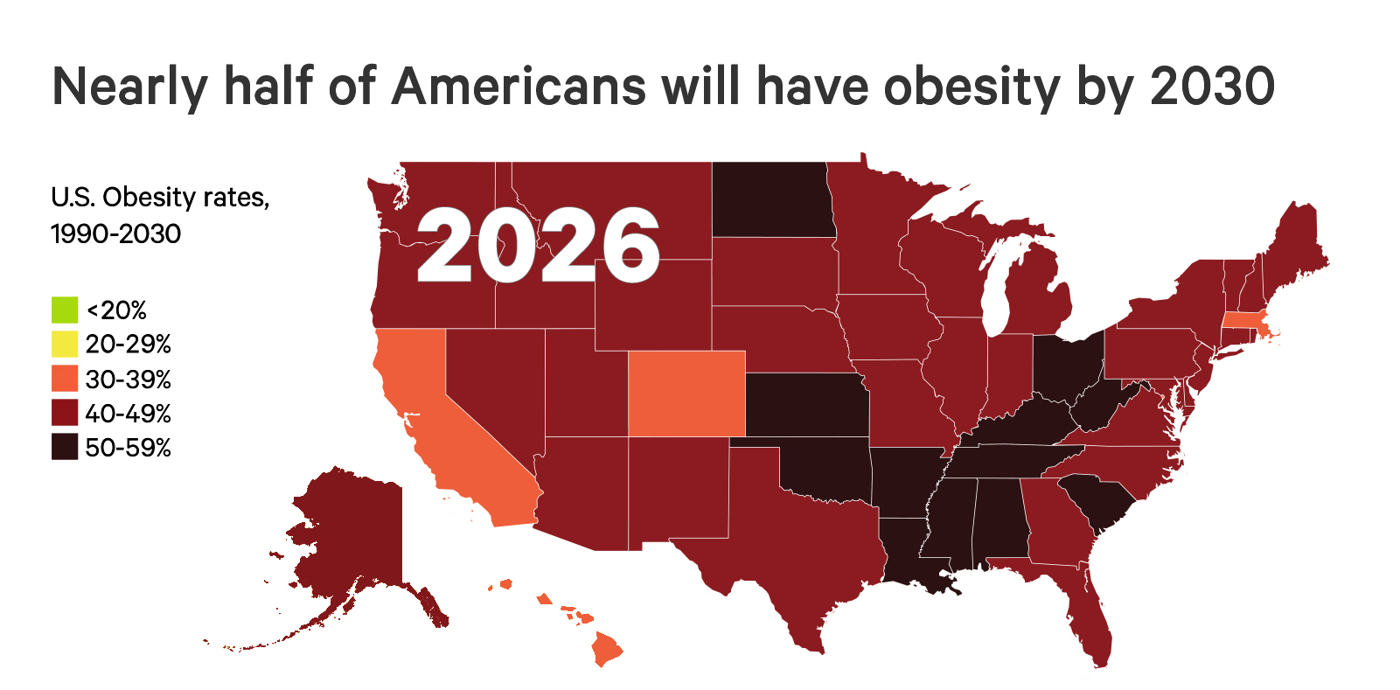
The Future of Obesity in the U.S.
Ward ZJ, Bleich SN, Cradock AL, Barrett JL, Giles CM, Flax CN, Long MW, Gortmaker SL. Projected U.S. State-Level Prevalence of Adult Obesity and Severe Obesity. New England Journal of Medicine. 2019;381:2440-50. doi: 10.1056/NEJMsa1909301

Slide 38
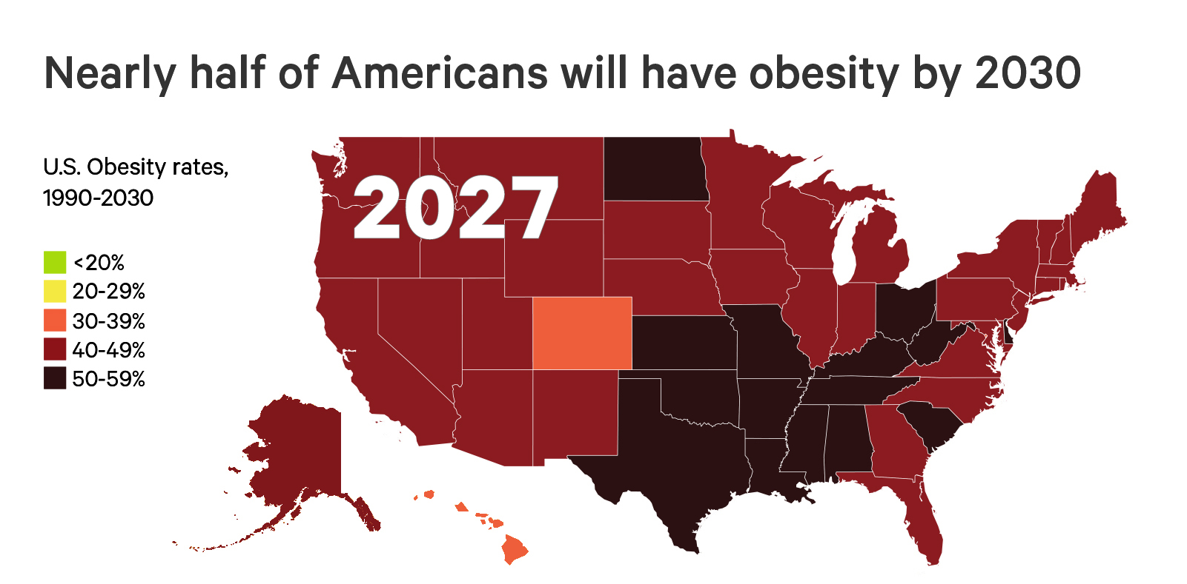
The Future of Obesity in the U.S.
Ward ZJ, Bleich SN, Cradock AL, Barrett JL, Giles CM, Flax CN, Long MW, Gortmaker SL. Projected U.S. State-Level Prevalence of Adult Obesity and Severe Obesity. New England Journal of Medicine. 2019;381:2440-50. doi: 10.1056/NEJMsa1909301

Slide 39
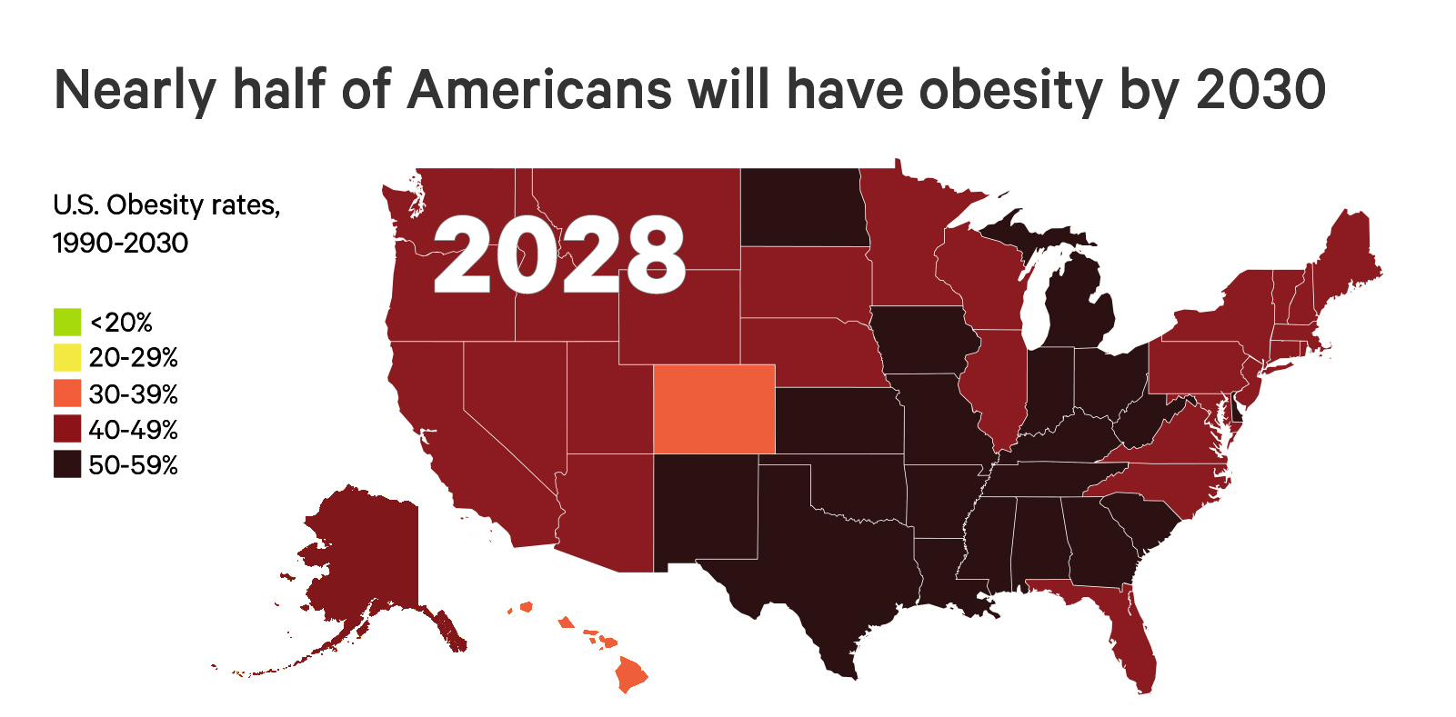
The Future of Obesity in the U.S.
Ward ZJ, Bleich SN, Cradock AL, Barrett JL, Giles CM, Flax CN, Long MW, Gortmaker SL. Projected U.S. State-Level Prevalence of Adult Obesity and Severe Obesity. New England Journal of Medicine. 2019;381:2440-50. doi: 10.1056/NEJMsa1909301

Slide 40
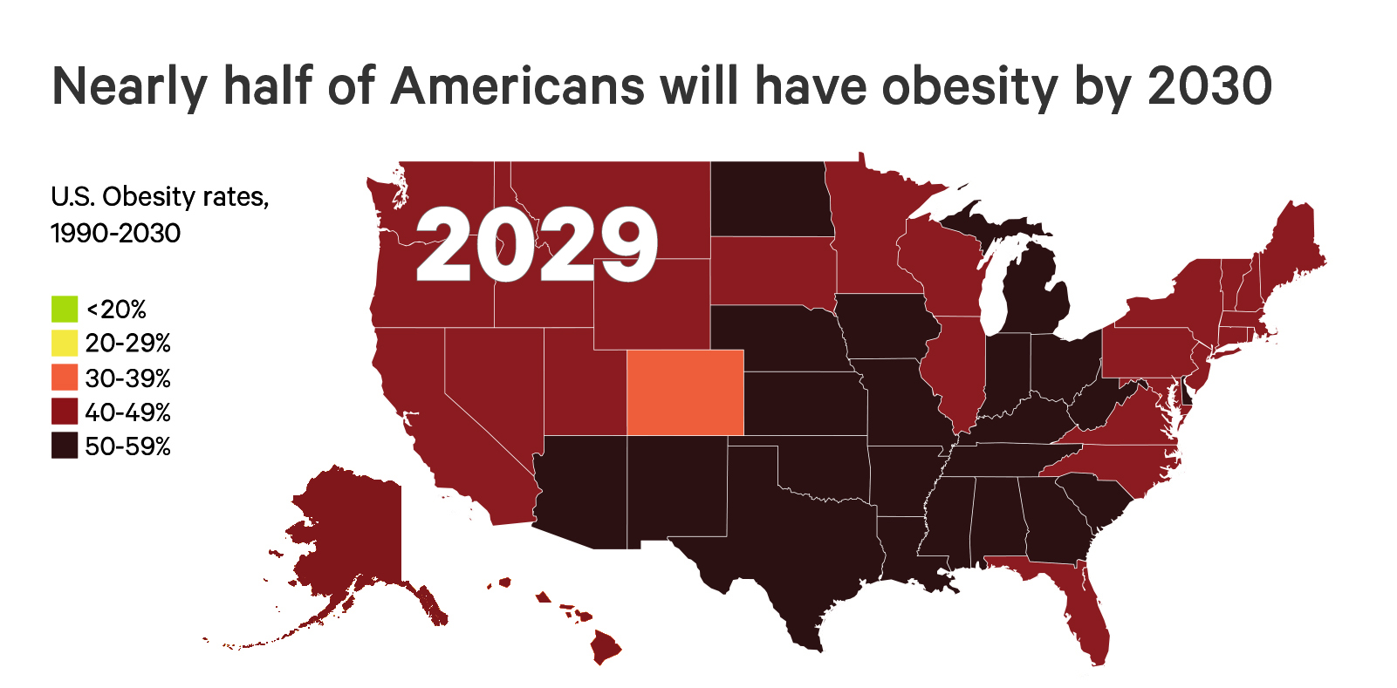
The Future of Obesity in the U.S.
Ward ZJ, Bleich SN, Cradock AL, Barrett JL, Giles CM, Flax CN, Long MW, Gortmaker SL. Projected U.S. State-Level Prevalence of Adult Obesity and Severe Obesity. New England Journal of Medicine. 2019;381:2440-50. doi: 10.1056/NEJMsa1909301

Slide 41
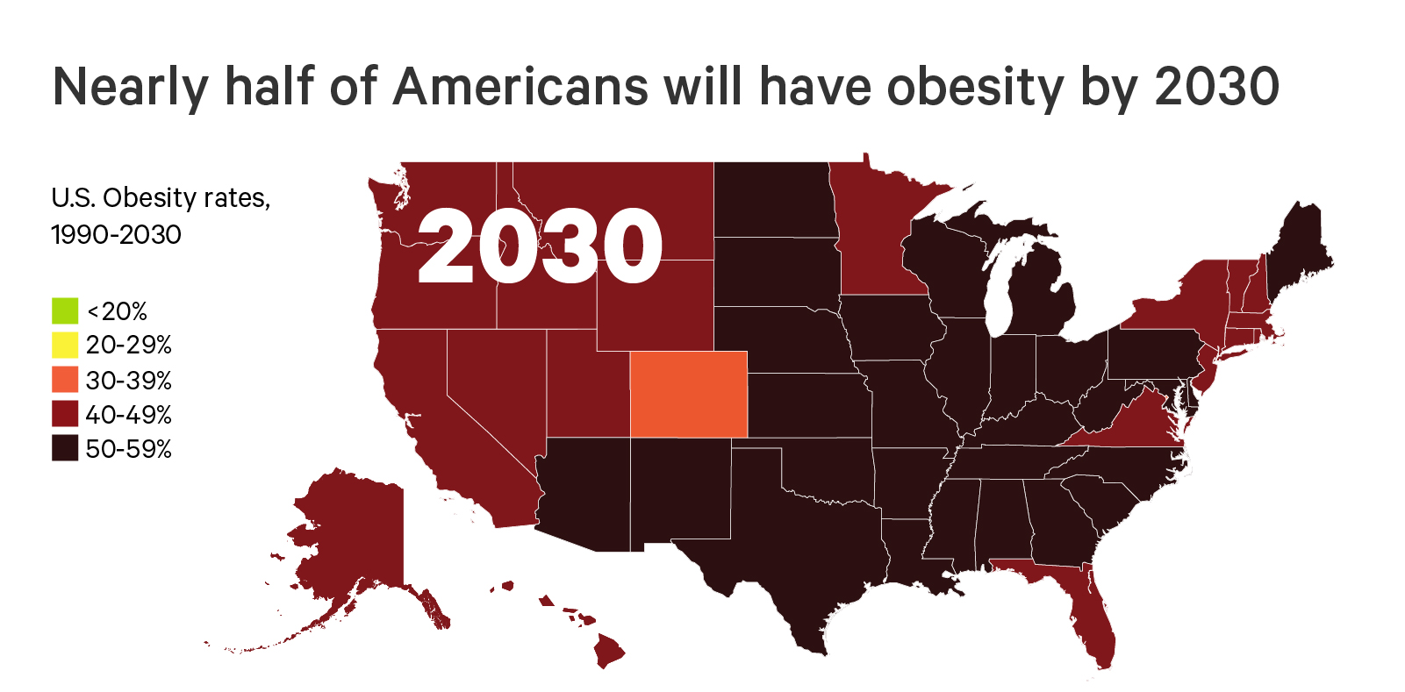
The Future of Obesity in the U.S.
Ward ZJ, Bleich SN, Cradock AL, Barrett JL, Giles CM, Flax CN, Long MW, Gortmaker SL. Projected U.S. State-Level Prevalence of Adult Obesity and Severe Obesity. New England Journal of Medicine. 2019;381:2440-50. doi: 10.1056/NEJMsa1909301

Slide 42
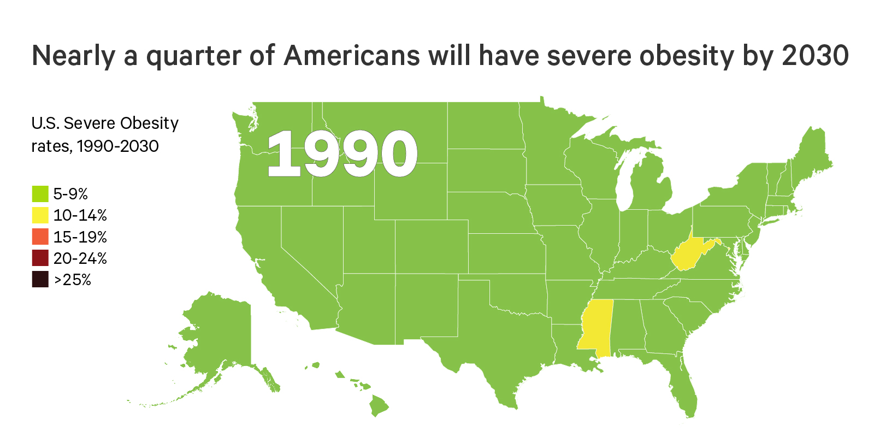
The Future of Severe Obesity in the U.S.
Ward ZJ, Bleich SN, Cradock AL, Barrett JL, Giles CM, Flax CN, Long MW, Gortmaker SL. Projected U.S. State-Level Prevalence of Adult Obesity and Severe Obesity. New England Journal of Medicine. 2019;381:2440-50. doi: 10.1056/NEJMsa1909301

Slide 43
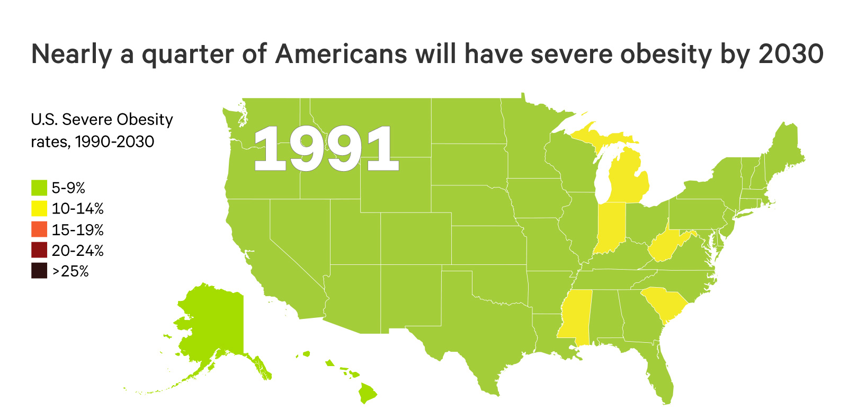
The Future of Severe Obesity in the U.S.
Ward ZJ, Bleich SN, Cradock AL, Barrett JL, Giles CM, Flax CN, Long MW, Gortmaker SL. Projected U.S. State-Level Prevalence of Adult Obesity and Severe Obesity. New England Journal of Medicine. 2019;381:2440-50. doi: 10.1056/NEJMsa1909301

Slide 44
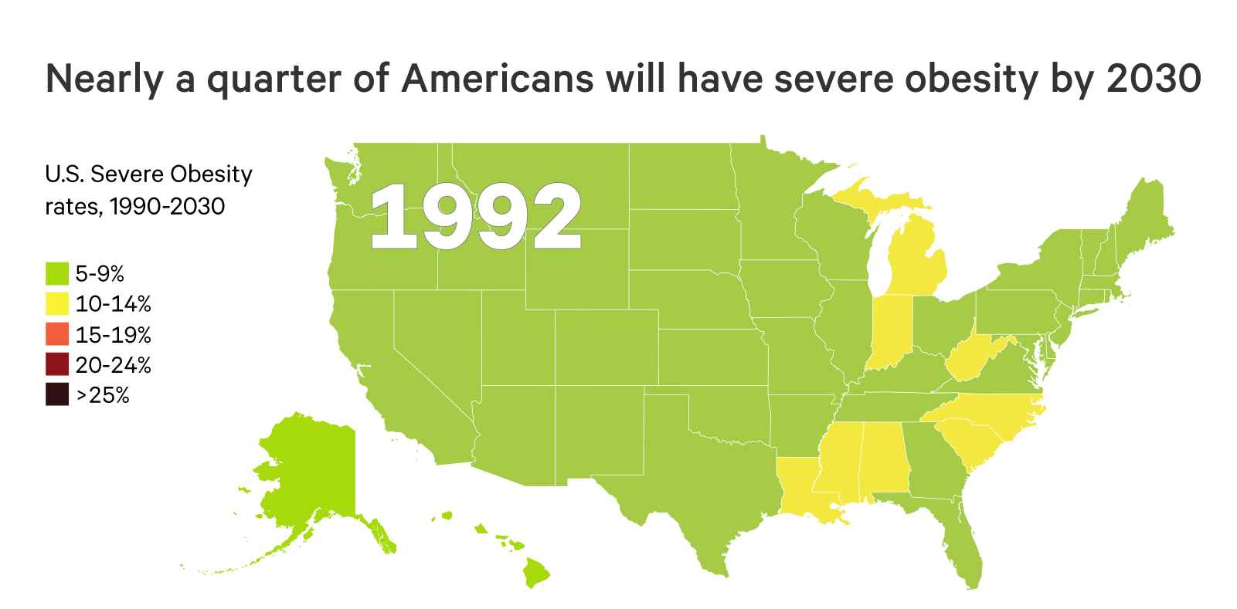
The Future of Severe Obesity in the U.S.
Ward ZJ, Bleich SN, Cradock AL, Barrett JL, Giles CM, Flax CN, Long MW, Gortmaker SL. Projected U.S. State-Level Prevalence of Adult Obesity and Severe Obesity. New England Journal of Medicine. 2019;381:2440-50. doi: 10.1056/NEJMsa1909301

Slide 45
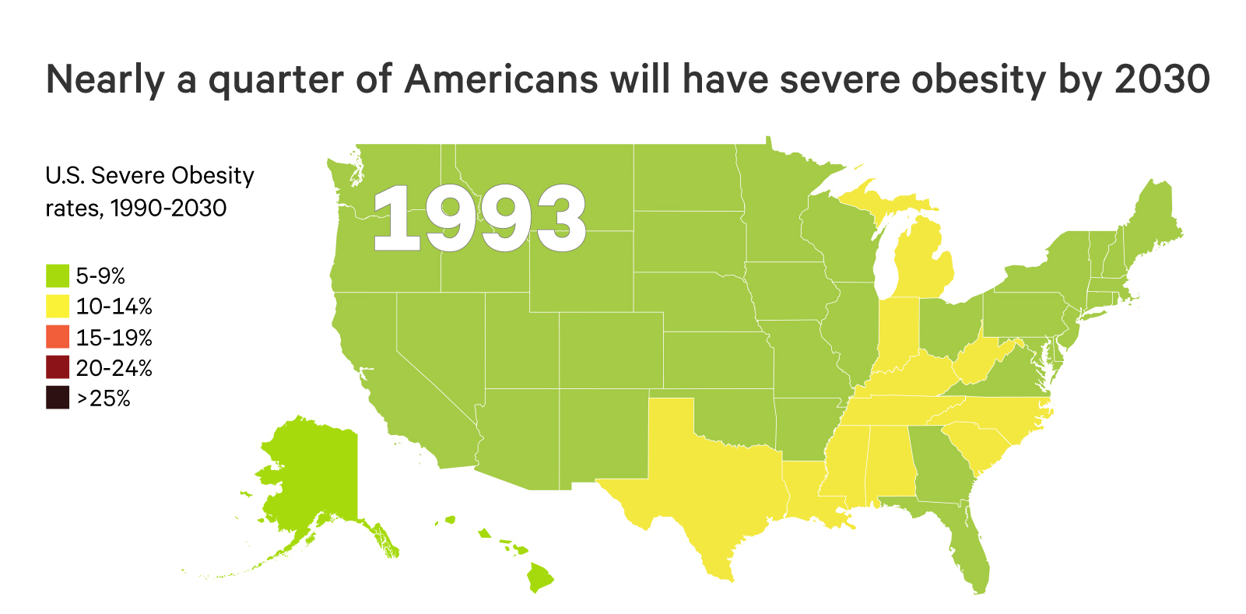
The Future of Severe Obesity in the U.S.
Ward ZJ, Bleich SN, Cradock AL, Barrett JL, Giles CM, Flax CN, Long MW, Gortmaker SL. Projected U.S. State-Level Prevalence of Adult Obesity and Severe Obesity. New England Journal of Medicine. 2019;381:2440-50. doi: 10.1056/NEJMsa1909301

Slide 46
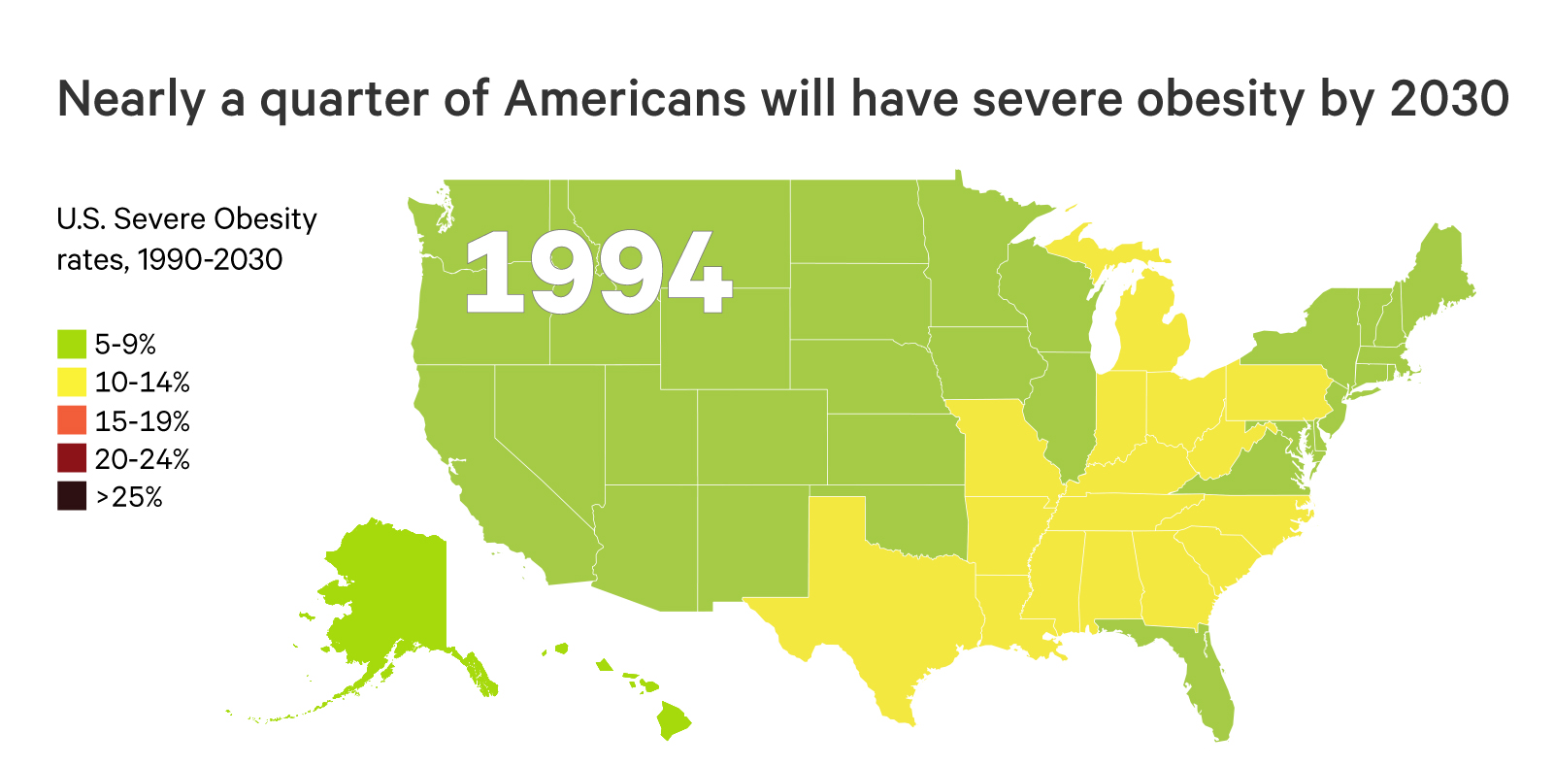
The Future of Severe Obesity in the U.S.
Ward ZJ, Bleich SN, Cradock AL, Barrett JL, Giles CM, Flax CN, Long MW, Gortmaker SL. Projected U.S. State-Level Prevalence of Adult Obesity and Severe Obesity. New England Journal of Medicine. 2019;381:2440-50. doi: 10.1056/NEJMsa1909301

Slide 47
The Future of Severe Obesity in the U.S.
Ward ZJ, Bleich SN, Cradock AL, Barrett JL, Giles CM, Flax CN, Long MW, Gortmaker SL. Projected U.S. State-Level Prevalence of Adult Obesity and Severe Obesity. New England Journal of Medicine. 2019;381:2440-50. doi: 10.1056/NEJMsa1909301

Slide 48
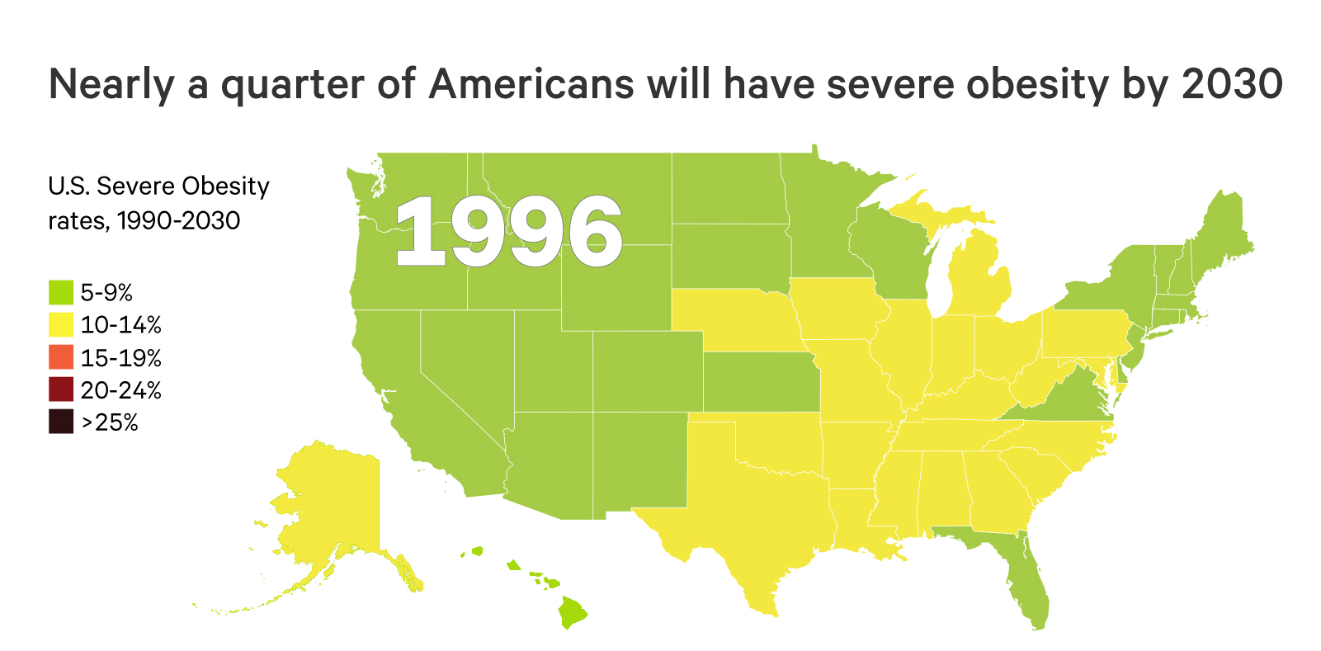
The Future of Severe Obesity in the U.S.
Ward ZJ, Bleich SN, Cradock AL, Barrett JL, Giles CM, Flax CN, Long MW, Gortmaker SL. Projected U.S. State-Level Prevalence of Adult Obesity and Severe Obesity. New England Journal of Medicine. 2019;381:2440-50. doi: 10.1056/NEJMsa1909301

Slide 49
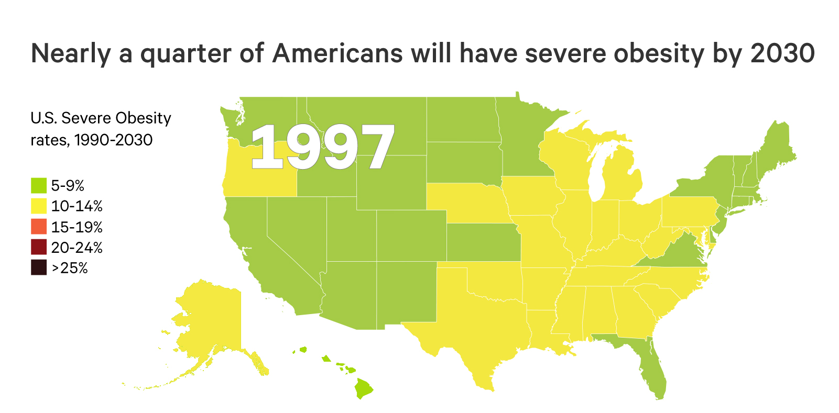
The Future of Severe Obesity in the U.S.
Ward ZJ, Bleich SN, Cradock AL, Barrett JL, Giles CM, Flax CN, Long MW, Gortmaker SL. Projected U.S. State-Level Prevalence of Adult Obesity and Severe Obesity. New England Journal of Medicine. 2019;381:2440-50. doi: 10.1056/NEJMsa1909301

Slide 50
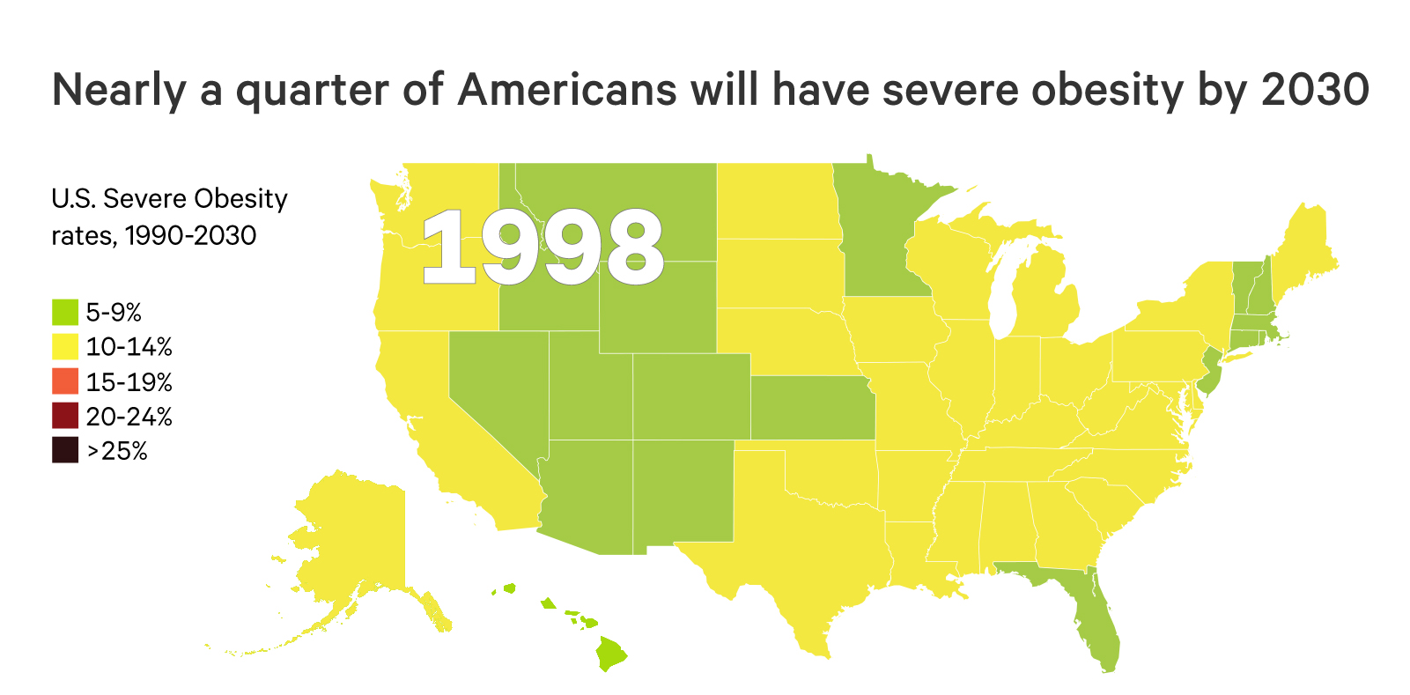
The Future of Severe Obesity in the U.S.
Ward ZJ, Bleich SN, Cradock AL, Barrett JL, Giles CM, Flax CN, Long MW, Gortmaker SL. Projected U.S. State-Level Prevalence of Adult Obesity and Severe Obesity. New England Journal of Medicine. 2019;381:2440-50. doi: 10.1056/NEJMsa1909301

Slide 51
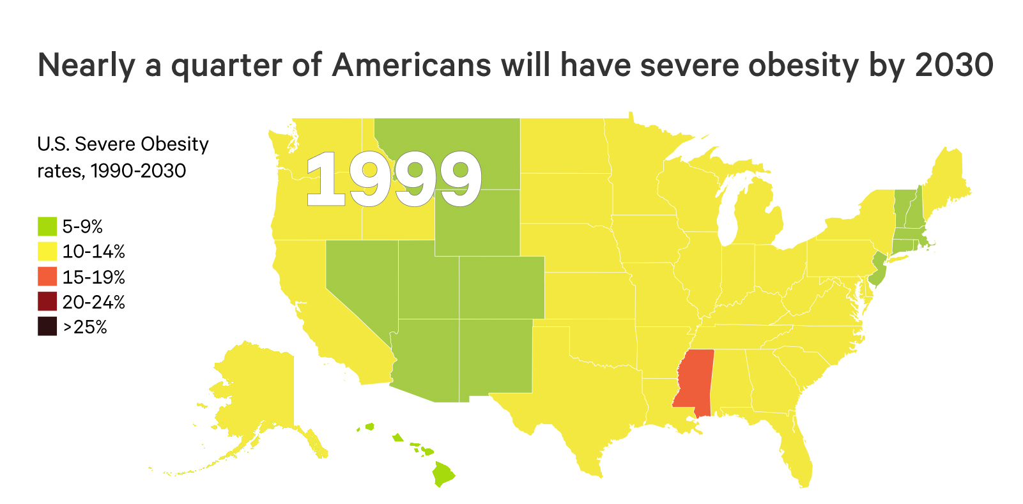
The Future of Severe Obesity in the U.S.
Ward ZJ, Bleich SN, Cradock AL, Barrett JL, Giles CM, Flax CN, Long MW, Gortmaker SL. Projected U.S. State-Level Prevalence of Adult Obesity and Severe Obesity. New England Journal of Medicine. 2019;381:2440-50. doi: 10.1056/NEJMsa1909301

Slide 52
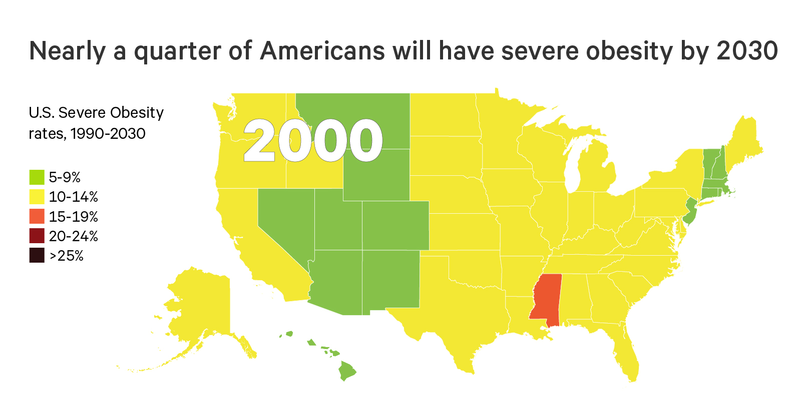
The Future of Severe Obesity in the U.S.
Ward ZJ, Bleich SN, Cradock AL, Barrett JL, Giles CM, Flax CN, Long MW, Gortmaker SL. Projected U.S. State-Level Prevalence of Adult Obesity and Severe Obesity. New England Journal of Medicine. 2019;381:2440-50. doi: 10.1056/NEJMsa1909301

Slide 53
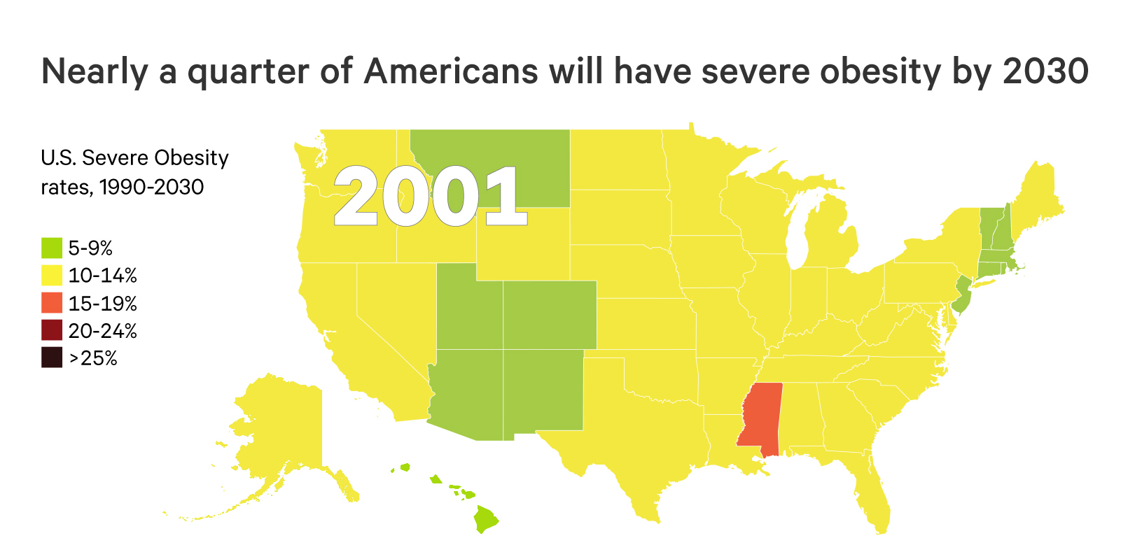
The Future of Severe Obesity in the U.S.
Ward ZJ, Bleich SN, Cradock AL, Barrett JL, Giles CM, Flax CN, Long MW, Gortmaker SL. Projected U.S. State-Level Prevalence of Adult Obesity and Severe Obesity. New England Journal of Medicine. 2019;381:2440-50. doi: 10.1056/NEJMsa1909301

Slide 54
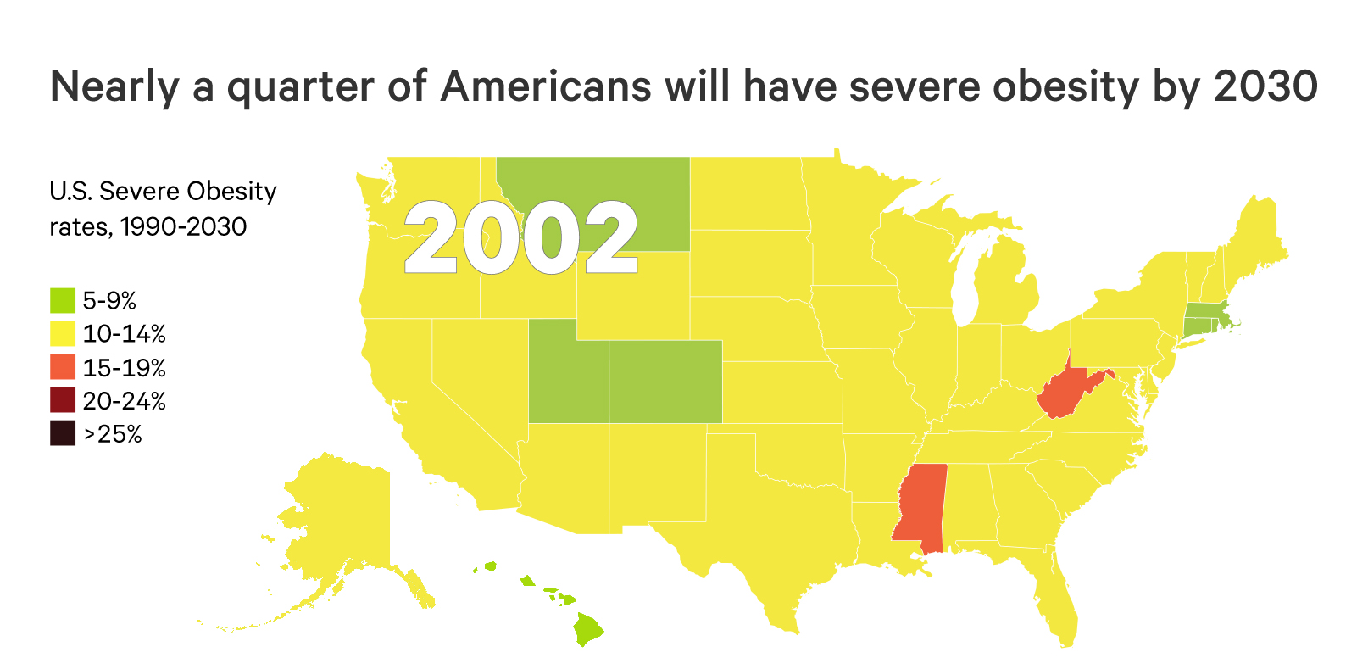
The Future of Severe Obesity in the U.S.
Ward ZJ, Bleich SN, Cradock AL, Barrett JL, Giles CM, Flax CN, Long MW, Gortmaker SL. Projected U.S. State-Level Prevalence of Adult Obesity and Severe Obesity. New England Journal of Medicine. 2019;381:2440-50. doi: 10.1056/NEJMsa1909301

Slide 55
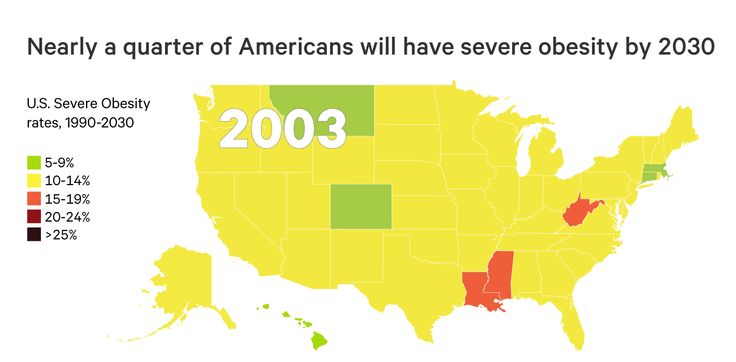
The Future of Severe Obesity in the U.S.
Ward ZJ, Bleich SN, Cradock AL, Barrett JL, Giles CM, Flax CN, Long MW, Gortmaker SL. Projected U.S. State-Level Prevalence of Adult Obesity and Severe Obesity. New England Journal of Medicine. 2019;381:2440-50. doi: 10.1056/NEJMsa1909301

Slide 56
The Future of Severe Obesity in the U.S.
Ward ZJ, Bleich SN, Cradock AL, Barrett JL, Giles CM, Flax CN, Long MW, Gortmaker SL. Projected U.S. State-Level Prevalence of Adult Obesity and Severe Obesity. New England Journal of Medicine. 2019;381:2440-50. doi: 10.1056/NEJMsa1909301

Slide 57
The Future of Severe Obesity in the U.S.
Ward ZJ, Bleich SN, Cradock AL, Barrett JL, Giles CM, Flax CN, Long MW, Gortmaker SL. Projected U.S. State-Level Prevalence of Adult Obesity and Severe Obesity. New England Journal of Medicine. 2019;381:2440-50. doi: 10.1056/NEJMsa1909301

Slide 58
The Future of Severe Obesity in the U.S.
Ward ZJ, Bleich SN, Cradock AL, Barrett JL, Giles CM, Flax CN, Long MW, Gortmaker SL. Projected U.S. State-Level Prevalence of Adult Obesity and Severe Obesity. New England Journal of Medicine. 2019;381:2440-50. doi: 10.1056/NEJMsa1909301

Slide 59
The Future of Severe Obesity in the U.S.
Ward ZJ, Bleich SN, Cradock AL, Barrett JL, Giles CM, Flax CN, Long MW, Gortmaker SL. Projected U.S. State-Level Prevalence of Adult Obesity and Severe Obesity. New England Journal of Medicine. 2019;381:2440-50. doi: 10.1056/NEJMsa1909301

Slide 60
The Future of Severe Obesity in the U.S.
Ward ZJ, Bleich SN, Cradock AL, Barrett JL, Giles CM, Flax CN, Long MW, Gortmaker SL. Projected U.S. State-Level Prevalence of Adult Obesity and Severe Obesity. New England Journal of Medicine. 2019;381:2440-50. doi: 10.1056/NEJMsa1909301

Slide 61
The Future of Severe Obesity in the U.S.
Ward ZJ, Bleich SN, Cradock AL, Barrett JL, Giles CM, Flax CN, Long MW, Gortmaker SL. Projected U.S. State-Level Prevalence of Adult Obesity and Severe Obesity. New England Journal of Medicine. 2019;381:2440-50. doi: 10.1056/NEJMsa1909301

Slide 62
The Future of Severe Obesity in the U.S.
Ward ZJ, Bleich SN, Cradock AL, Barrett JL, Giles CM, Flax CN, Long MW, Gortmaker SL. Projected U.S. State-Level Prevalence of Adult Obesity and Severe Obesity. New England Journal of Medicine. 2019;381:2440-50. doi: 10.1056/NEJMsa1909301

Slide 63
The Future of Severe Obesity in the U.S.
Ward ZJ, Bleich SN, Cradock AL, Barrett JL, Giles CM, Flax CN, Long MW, Gortmaker SL. Projected U.S. State-Level Prevalence of Adult Obesity and Severe Obesity. New England Journal of Medicine. 2019;381:2440-50. doi: 10.1056/NEJMsa1909301

Slide 64
The Future of Severe Obesity in the U.S.
Ward ZJ, Bleich SN, Cradock AL, Barrett JL, Giles CM, Flax CN, Long MW, Gortmaker SL. Projected U.S. State-Level Prevalence of Adult Obesity and Severe Obesity. New England Journal of Medicine. 2019;381:2440-50. doi: 10.1056/NEJMsa1909301

Slide 65
The Future of Severe Obesity in the U.S.
Ward ZJ, Bleich SN, Cradock AL, Barrett JL, Giles CM, Flax CN, Long MW, Gortmaker SL. Projected U.S. State-Level Prevalence of Adult Obesity and Severe Obesity. New England Journal of Medicine. 2019;381:2440-50. doi: 10.1056/NEJMsa1909301

Slide 66
The Future of Severe Obesity in the U.S.
Ward ZJ, Bleich SN, Cradock AL, Barrett JL, Giles CM, Flax CN, Long MW, Gortmaker SL. Projected U.S. State-Level Prevalence of Adult Obesity and Severe Obesity. New England Journal of Medicine. 2019;381:2440-50. doi: 10.1056/NEJMsa1909301

Slide 67
The Future of Severe Obesity in the U.S.
Ward ZJ, Bleich SN, Cradock AL, Barrett JL, Giles CM, Flax CN, Long MW, Gortmaker SL. Projected U.S. State-Level Prevalence of Adult Obesity and Severe Obesity. New England Journal of Medicine. 2019;381:2440-50. doi: 10.1056/NEJMsa1909301

Slide 68
The Future of Severe Obesity in the U.S.
Ward ZJ, Bleich SN, Cradock AL, Barrett JL, Giles CM, Flax CN, Long MW, Gortmaker SL. Projected U.S. State-Level Prevalence of Adult Obesity and Severe Obesity. New England Journal of Medicine. 2019;381:2440-50. doi: 10.1056/NEJMsa1909301

Slide 69
The Future of Severe Obesity in the U.S.
Ward ZJ, Bleich SN, Cradock AL, Barrett JL, Giles CM, Flax CN, Long MW, Gortmaker SL. Projected U.S. State-Level Prevalence of Adult Obesity and Severe Obesity. New England Journal of Medicine. 2019;381:2440-50. doi: 10.1056/NEJMsa1909301

Slide 70
The Future of Severe Obesity in the U.S.
Ward ZJ, Bleich SN, Cradock AL, Barrett JL, Giles CM, Flax CN, Long MW, Gortmaker SL. Projected U.S. State-Level Prevalence of Adult Obesity and Severe Obesity. New England Journal of Medicine. 2019;381:2440-50. doi: 10.1056/NEJMsa1909301

Slide 71
The Future of Severe Obesity in the U.S.
Ward ZJ, Bleich SN, Cradock AL, Barrett JL, Giles CM, Flax CN, Long MW, Gortmaker SL. Projected U.S. State-Level Prevalence of Adult Obesity and Severe Obesity. New England Journal of Medicine. 2019;381:2440-50. doi: 10.1056/NEJMsa1909301

Slide 72
The Future of Severe Obesity in the U.S.
Ward ZJ, Bleich SN, Cradock AL, Barrett JL, Giles CM, Flax CN, Long MW, Gortmaker SL. Projected U.S. State-Level Prevalence of Adult Obesity and Severe Obesity. New England Journal of Medicine. 2019;381:2440-50. doi: 10.1056/NEJMsa1909301

Slide 73
The Future of Severe Obesity in the U.S.
Ward ZJ, Bleich SN, Cradock AL, Barrett JL, Giles CM, Flax CN, Long MW, Gortmaker SL. Projected U.S. State-Level Prevalence of Adult Obesity and Severe Obesity. New England Journal of Medicine. 2019;381:2440-50. doi: 10.1056/NEJMsa1909301

Slide 74
The Future of Severe Obesity in the U.S.
Ward ZJ, Bleich SN, Cradock AL, Barrett JL, Giles CM, Flax CN, Long MW, Gortmaker SL. Projected U.S. State-Level Prevalence of Adult Obesity and Severe Obesity. New England Journal of Medicine. 2019;381:2440-50. doi: 10.1056/NEJMsa1909301

Slide 75
The Future of Severe Obesity in the U.S.
Ward ZJ, Bleich SN, Cradock AL, Barrett JL, Giles CM, Flax CN, Long MW, Gortmaker SL. Projected U.S. State-Level Prevalence of Adult Obesity and Severe Obesity. New England Journal of Medicine. 2019;381:2440-50. doi: 10.1056/NEJMsa1909301

Slide 76
The Future of Severe Obesity in the U.S.
Ward ZJ, Bleich SN, Cradock AL, Barrett JL, Giles CM, Flax CN, Long MW, Gortmaker SL. Projected U.S. State-Level Prevalence of Adult Obesity and Severe Obesity. New England Journal of Medicine. 2019;381:2440-50. doi: 10.1056/NEJMsa1909301

Slide 77
The Future of Severe Obesity in the U.S.
Ward ZJ, Bleich SN, Cradock AL, Barrett JL, Giles CM, Flax CN, Long MW, Gortmaker SL. Projected U.S. State-Level Prevalence of Adult Obesity and Severe Obesity. New England Journal of Medicine. 2019;381:2440-50. doi: 10.1056/NEJMsa1909301

Slide 78
The Future of Severe Obesity in the U.S.
Ward ZJ, Bleich SN, Cradock AL, Barrett JL, Giles CM, Flax CN, Long MW, Gortmaker SL. Projected U.S. State-Level Prevalence of Adult Obesity and Severe Obesity. New England Journal of Medicine. 2019;381:2440-50. doi: 10.1056/NEJMsa1909301

Slide 79
The Future of Severe Obesity in the U.S.
Ward ZJ, Bleich SN, Cradock AL, Barrett JL, Giles CM, Flax CN, Long MW, Gortmaker SL. Projected U.S. State-Level Prevalence of Adult Obesity and Severe Obesity. New England Journal of Medicine. 2019;381:2440-50. doi: 10.1056/NEJMsa1909301

Slide 80
The Future of Severe Obesity in the U.S.
Ward ZJ, Bleich SN, Cradock AL, Barrett JL, Giles CM, Flax CN, Long MW, Gortmaker SL. Projected U.S. State-Level Prevalence of Adult Obesity and Severe Obesity. New England Journal of Medicine. 2019;381:2440-50. doi: 10.1056/NEJMsa1909301

Slide 81
The Future of Severe Obesity in the U.S.
Ward ZJ, Bleich SN, Cradock AL, Barrett JL, Giles CM, Flax CN, Long MW, Gortmaker SL. Projected U.S. State-Level Prevalence of Adult Obesity and Severe Obesity. New England Journal of Medicine. 2019;381:2440-50. doi: 10.1056/NEJMsa1909301

Slide 82
The Future of Severe Obesity in the U.S.
Ward ZJ, Bleich SN, Cradock AL, Barrett JL, Giles CM, Flax CN, Long MW, Gortmaker SL. Projected U.S. State-Level Prevalence of Adult Obesity and Severe Obesity. New England Journal of Medicine. 2019;381:2440-50. doi: 10.1056/NEJMsa1909301

